Slide 1
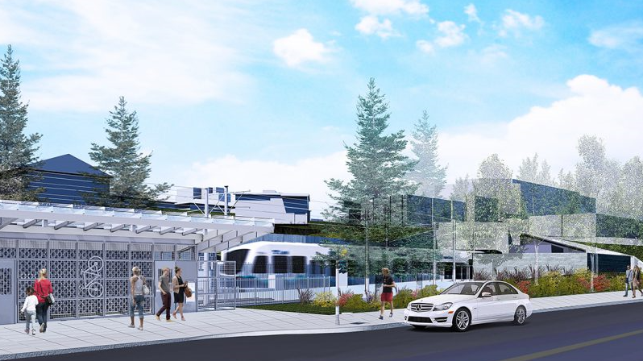
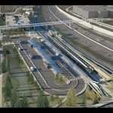
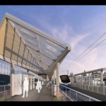
EAST MAIN TRANSIT ORIENTED DISTRICT
COMPREHENSIVE PLAN PUBLIC HEARING
NOVEMBER 07, 2018
Notes:
Presentation is for the benefit of both the Planning Commission and the audience.
Many people in the public have expressed an interest in this but have been unable to consistently track it throughout the year.
This presentation provides more background context for information purposes.

Slide 2
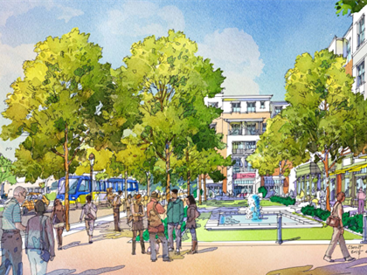
Why
A chance to capitalize and leverage the full potential around new station areas.
To realize a full range of public benefits that would not be otherwise possible.
Sensitivity to the region’s Growth Management Act .
To fulfill the city’s obligation to balance economic development and citizen well-being.
Proposed METRO Blue Line Minneapolis – St. Paul
Notes:
The Value Added Link – Property Values Increasingly Depend on Transit (2016, ULI)
Transit stations are becoming the placemaking value added areas of cities. With an instant market brought to your doorstep?
Where else can you add more land value in such a small footprint?
Public benefits that come from the vitality of the people that are brought to your doorstep.
Balancing. The Planning Commission’s role as the stewards, the enterprise guardians of the Comprehensive Plan.
Is this package of policy language consistent with the Bellevue Comprehensive Plan and will it further its intent.
To make that recommendation to Council.
To say to Council that
we, as a citizen’s lay board, reviewed the City’s premier and adopted statement of policy that defines how we, as a collective community, will grow now and in the future and
This is our recommendation how this new policy direction aligns with that plan.
That’s your primary responsibility tonight.

Slide 3
Context
$3.7 billion budgeted (East Link Video)
10 miles, 14 stations
  Start of service: 2023
  Projected ridership: 50,000 by 2030
Notes:
The service area:
¼ mile: N – 4th St; S – SE 6th, E – 116th, W – 108th
½ mile: N – 8th St, S – SE 8th, E – Bellevue Botannical Gardens, W – Bellevue Way
*Important to understand that larger context. People will be coming from all over this service area to use this station. Exception may be the north side because people will be able to access the downtown station at city hall.
Toggle over to Google Maps

Slide 4
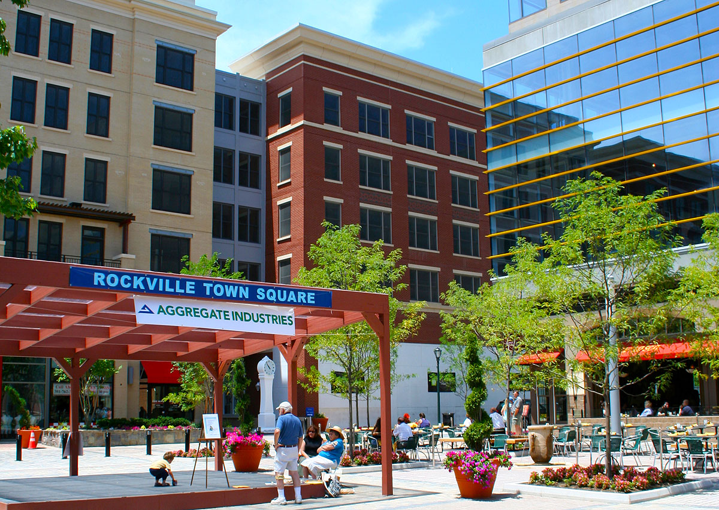
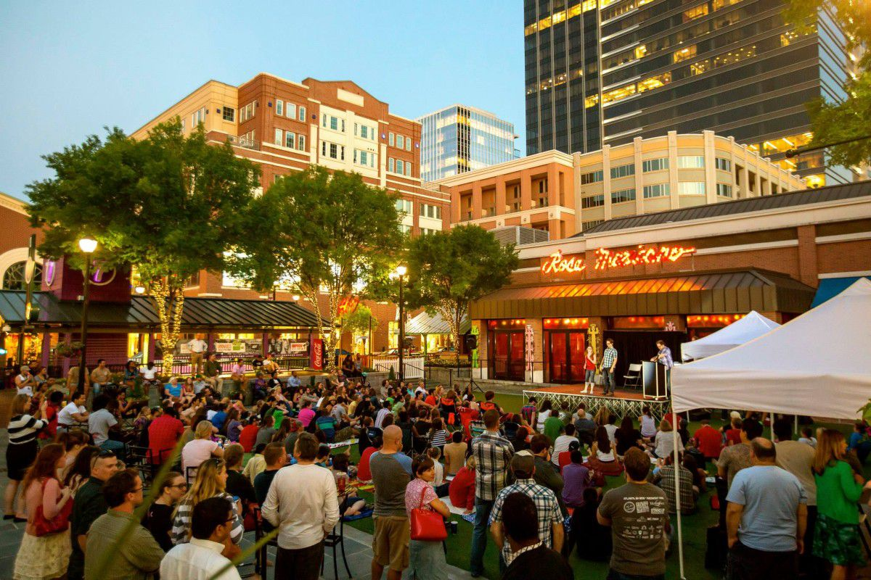
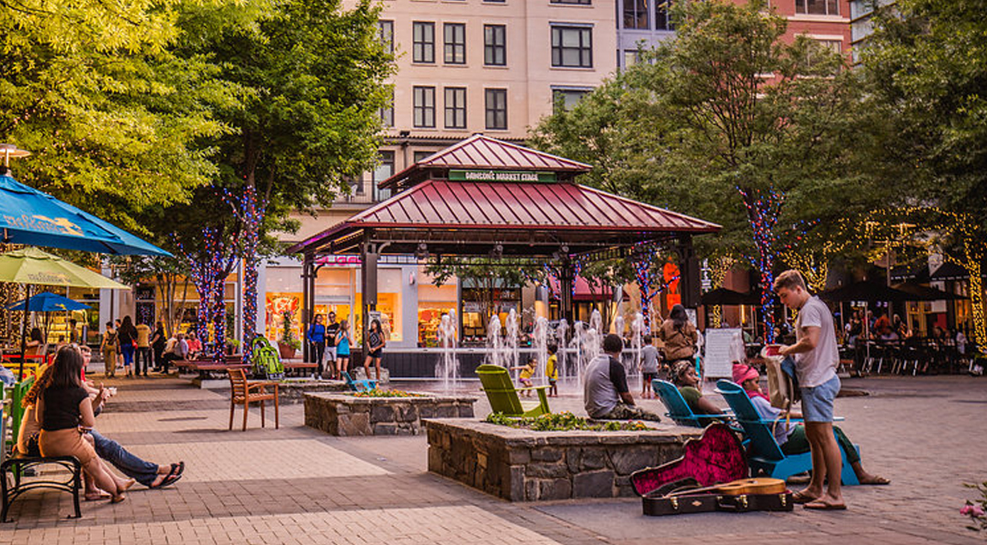
Context
Identity
Transit station as “place”
  Good public spaces build value
  Bellevue can compete
Atlantic Station, Atlanta GA
Rockville Town Center, Maryland
Notes:
The Opportunity
What is it – TOD Institute – Scroll down. Good short narrative about it.
Transit Oriented Development is the exciting fast growing trend in creating vibrant, livable, sustainable communities. Also known as TOD, it's the creation of compact, walkable, pedestrian-oriented, mixed-use communities centered around high quality train systems. This makes it possible to live a lower-stress life without complete dependence on a car for mobility and survival. FIRST LEFT SIDE PICTURE LINKS TO HEART MONITOR GRAPHIC.
Notice in these TOD pictures:
-Presence of people
-Lack of cars
-Interesting spaces that define place
-Ground level activity.
A new development type. Not downtown, not Bel-Red
-Small walkable blocks. Not the superblock of downtown
-Emphasis on placemaking.
-Activated street frontages.
-Primary orientation is to the transit station. Pedestrians and bicyclists are given high priority. Auto diet. Pulse/flow. Graphic of heart rate monitor and comparison to ebb and flow of passenger trains.

Slide 5
Station Area Planning
Comprehensive Plan
PC Plan Amendment Hearing
Council Study Session
Council Hearing
Land Development Code
PC Code Amendment Study Session(s)
PC Public Hearings
Nov 7
Nov 26
Dec 10
Dec 12
Jan 9
Jan 23
Feb 23
December
January
February

Slide 6
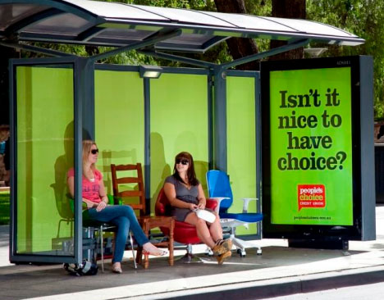
Proposed Policy Elements
Land Use: Compact urban development fully integrated with public transit
Transportation: a fully connected multi-modal publicly accessible network
Urban Design: A distinctive & pedestrian favorable public realm
Open Space: An attractive, city wide networked system
Natural Environment: A linked and sustainable system of natural flora & fauna
Notes:
Plus:
New definitions
A new future land use plan category – East Main Transit Oriented Development (EM-TOD)
The CAC plan recommends increases in development entitlements.
Today 0.5 floor area ratio OLB. Explain FAR
Proposed 4.0 FAR and 5.0 FAR (10 fold or 1000% increase in intensity)
10,000 ft2 of land at 0.5 FAR = 5,000 ft2 of building potential
10,000 ft2 of land at 5.0 FAR = 50,000 ft2 of building potential

Slide 7
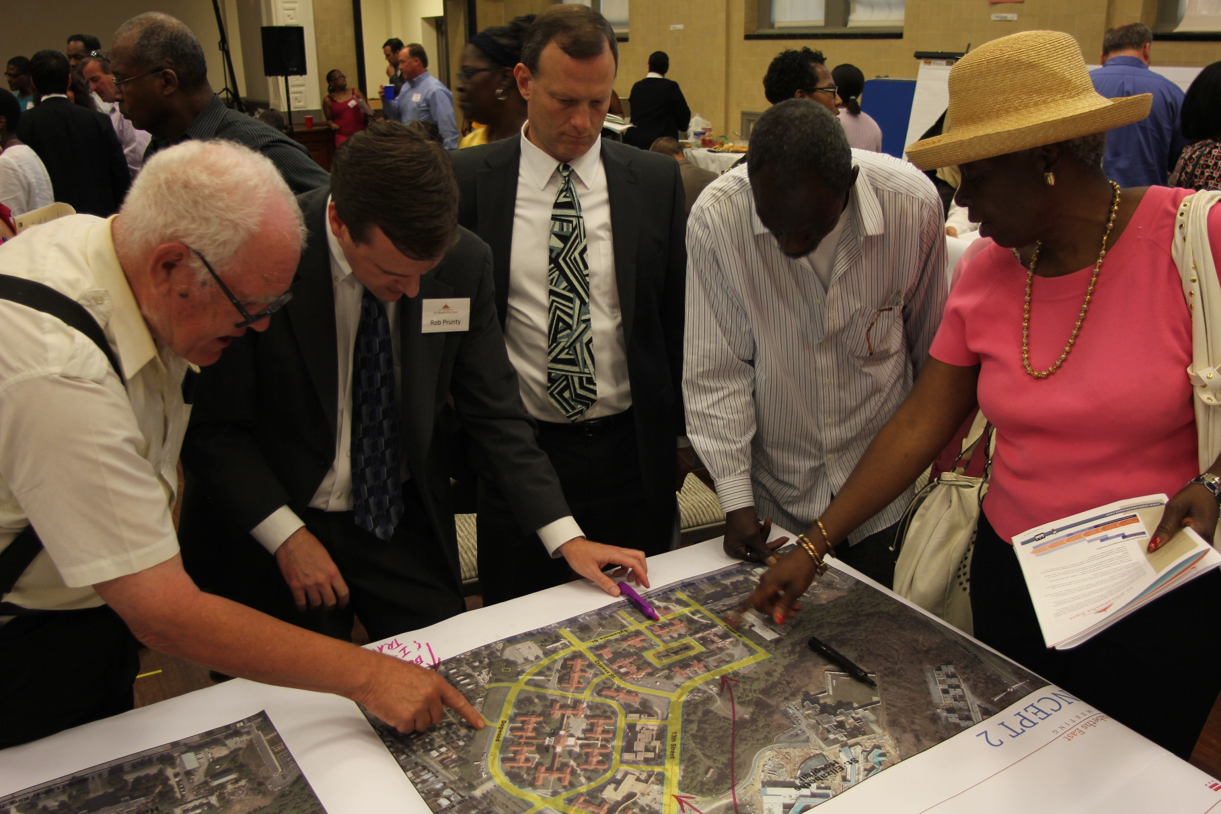
Stakeholder Engagement
8 Planning Commission meetings (incl. 2 walking tours & 6 study sessions) Jan – Sept 2018
2 Public Open Houses Feb 14, Sept 5, 2018

Slide 8

Stakeholder Requests
Request: Streets in the new street grid should not be dedicated streets.
Response: This is a transportation code issue.
Request: Allow larger floor plates for tech needs.
Response: This is a land use code issue.
Request: Alter structure height.
Response: This is a land use code issue.

Slide 9
Stakeholder Requests
Request: Allow skybridge connections.
Response: This undermines the intent to populate the street as the primary public realm.
Request: Eliminate the street specific diagram.
Response: Contrary to basis for entire station area plan.
Request: Rethink zoned building massing allocations.
Response: This is an urban design & land use code issue.
Notes:
Skybridge:
-Privatize the public realm
-The equity issues of ‘public’ in the plan
-Safety of pedestrians (planned crossing at 112th)
Illustrative street diagram
Elements of TOD
-Grid pattern
-Small walkable blocks
-Mobility (transportation)
-Connectivity to transit station (transportation)

Slide 10
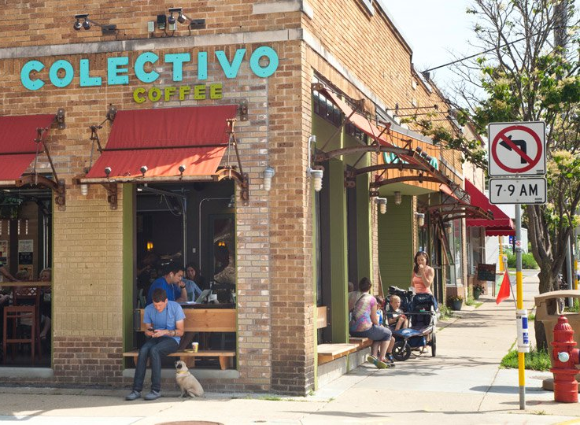
Stakeholder Comments
Comment: We need street level pedestrian crossings.
Comment: Inner street grid should be for people, not cars.
Comment: We need places to read books and have coffee with friends.
Notes:
Inner street grid. -Supports concept of public realm and ground level activity.
Coffee/books – Speaks to third places, community gathering, social connectivity.
In urban centers, most people socialize in the public realm. International cultures – socializing Crossroads Mall, downtown Park.
In suburban settings, much of that has been internalized into the private space of homes.

Slide 11
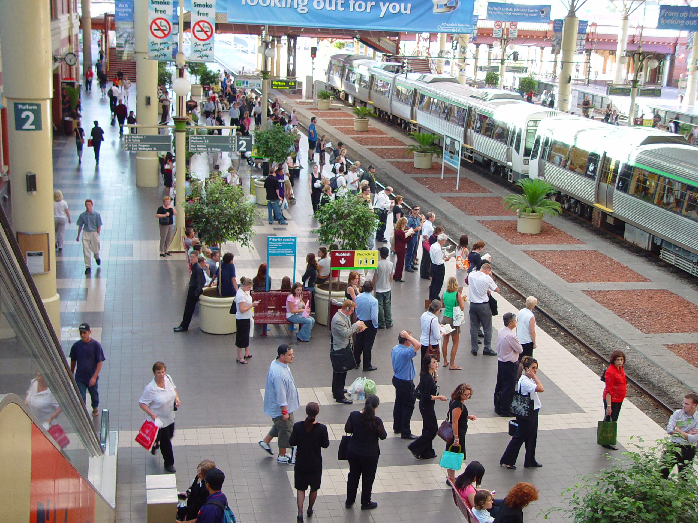
Stakeholder Comments
Comment: Daylight Sturtevant Creek.
Comment: Up-zone single family homes within 500 yards of station which should be used more.
Comment: Get people out of their cars.
Notes:
Sturtevant Creek – may go to Google maps

Slide 12

Policy Themes
The Public realm
Urban Design & Placemaking
Land use
Neighborhood character
Safety
Mobility & connectivity
Growth Strategy
Sustainability
Environment

Slide 13
Recommendation
Approve the resolution and advance to City Council

Slide 14
EAST MAIN TRANSIT ORIENTED DISTRICT
COMPREHENSIVE PLAN PUBLIC HEARING
NOVEMBER 07, 2018

Slide 15
