Slide 1
2018 Comprehensive Plan Amendments
Threshold Review and Geographic Scoping
Bellevue Planning Commission
Threshold Review Public Hearing June 27, 2018
Nicholas Matz AICP Terry Cullen AICP

Slide 2
2018 Annual Comprehensive Plan Amendments
Threshold Review and Geographic Scoping Public Hearing
The Comprehensive Plan is Bellevue’s foundational policy document…an amendment to the Plan is a mechanism by which the City may modify its land use, development or growth policies.
Land Use Code (LUC) 20.30I.120 – Purpose
Overview of the review process:
Limited to an annual process under GMA
Threshold Review recommendations =
  proposed annual work program
Annual work program established when City Council acts on Planning Commission recommendations (July)
Notes:
Policy Issues

Slide 3
2018 Annual Comprehensive Plan Amendments
Threshold Review and Geographic Scoping Public Hearing
Planning Commission tonight:
Conduct a Threshold Review public hearing for the proposed amendment
Conduct a study session following the public hearing to make a recommendation
Continue to conduct real-time auditing of tonight’s material and process
Notes:
Planning Commission Direction Needed
The three “C”s--

Slide 4
Newport Hills SC Redevelopment
Notes:
Chart and link page 2 of June 27 agenda memo

Slide 5
2018 Comprehensive Plan Amendments
Threshold Review and Geographic Scoping
Newport Hills Shopping Center Redevelopment
Threshold Review Public Hearing

Slide 6
Notes:
Privately-initiated application to:
-amend 6.4 acres of Newport Hills Subarea from NB to NMU
-amend relevant Subarea text to include references to NMU (see attachment 3)
-amend LU-19 to include references to NMU

Slide 8
2018 Annual Comprehensive Plan Amendments
Threshold Review and Geographic Scoping Public Hearing
The “tools” for successful revitalization
  1) a willing community
  2) willing businesses
  3) a willing property owner
  4) realistic assessment of market conditions
  5) an effective land use designation

Slide 9
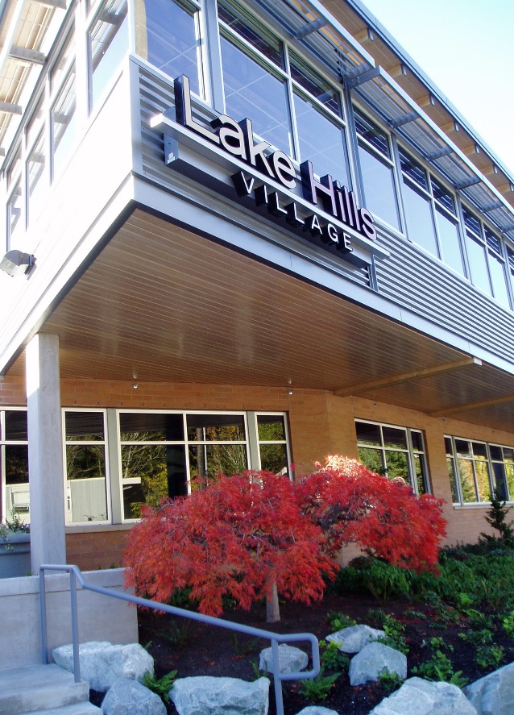
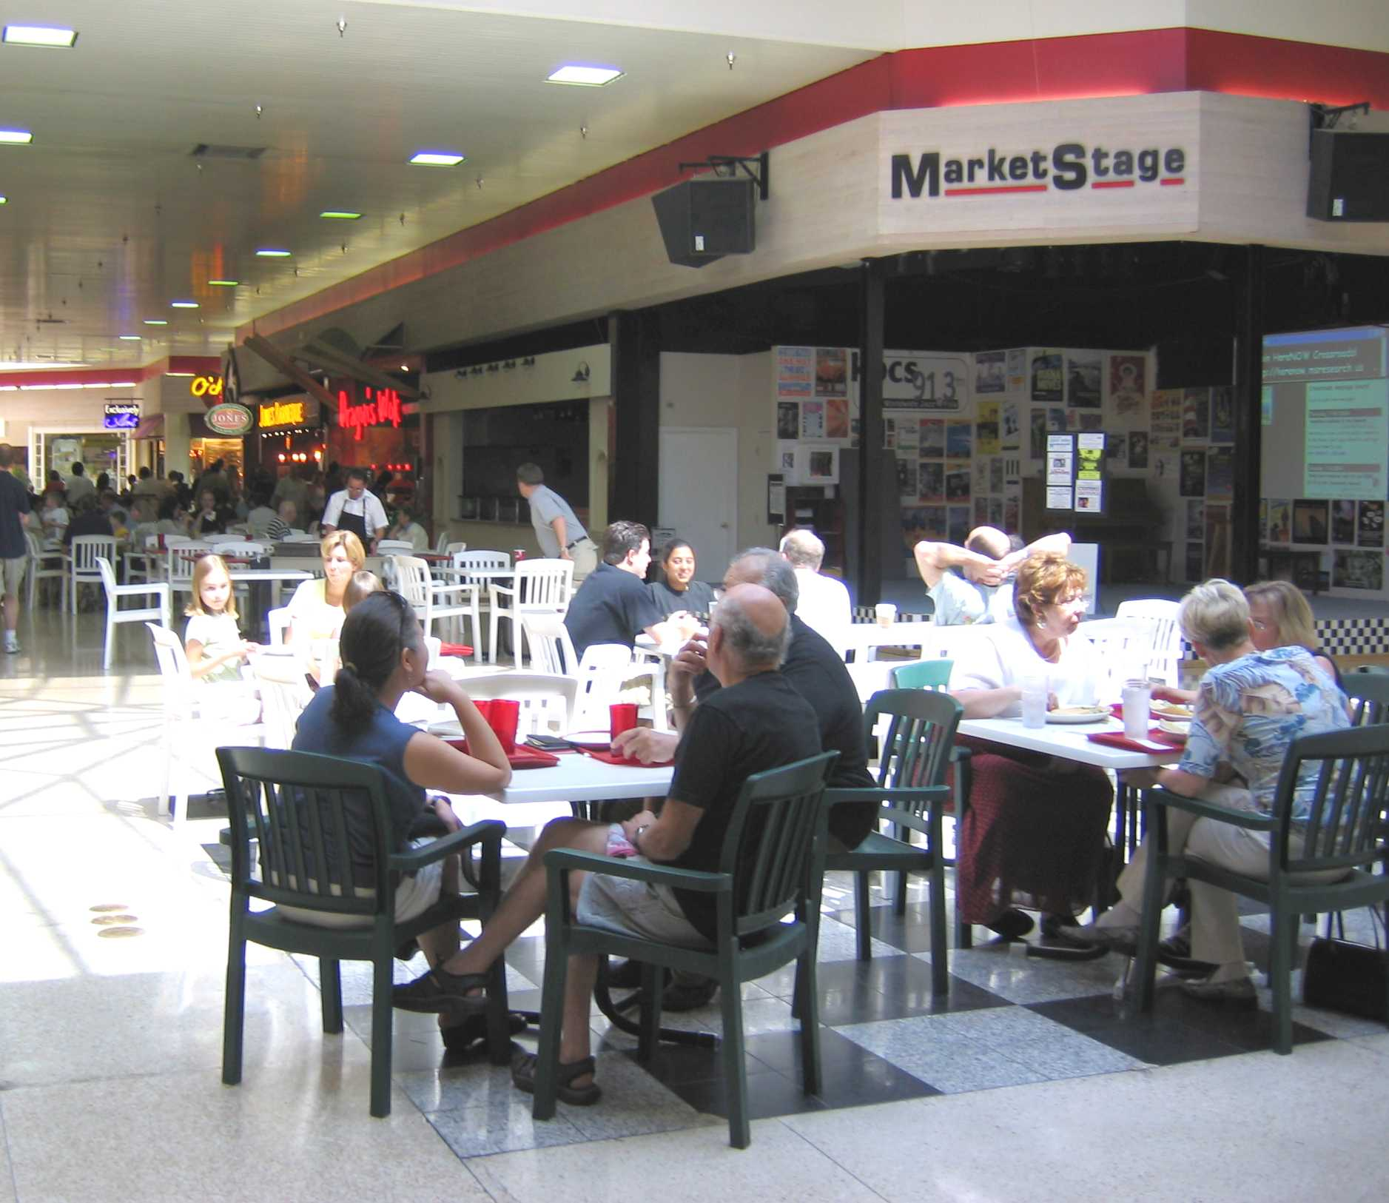
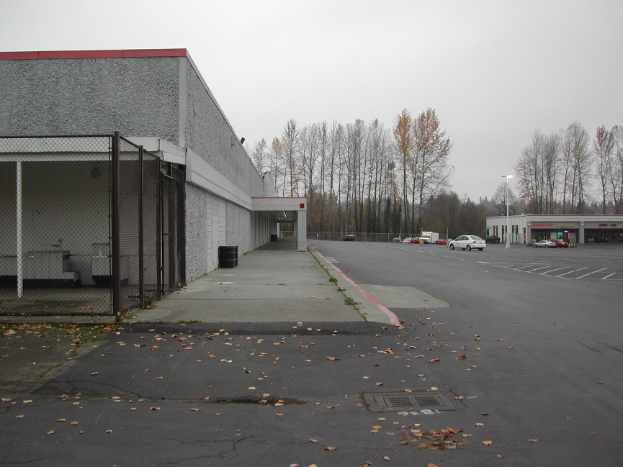
2018 Annual Comprehensive Plan Amendments
Threshold Review and Geographic Scoping Public Hearing
Aging Commercial Areas
Neighborhood Commercial Centers
Adaptability (Neighborhoods Element)

Slide 10
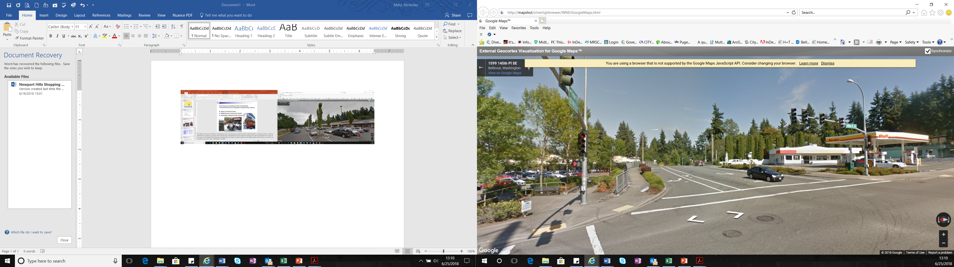
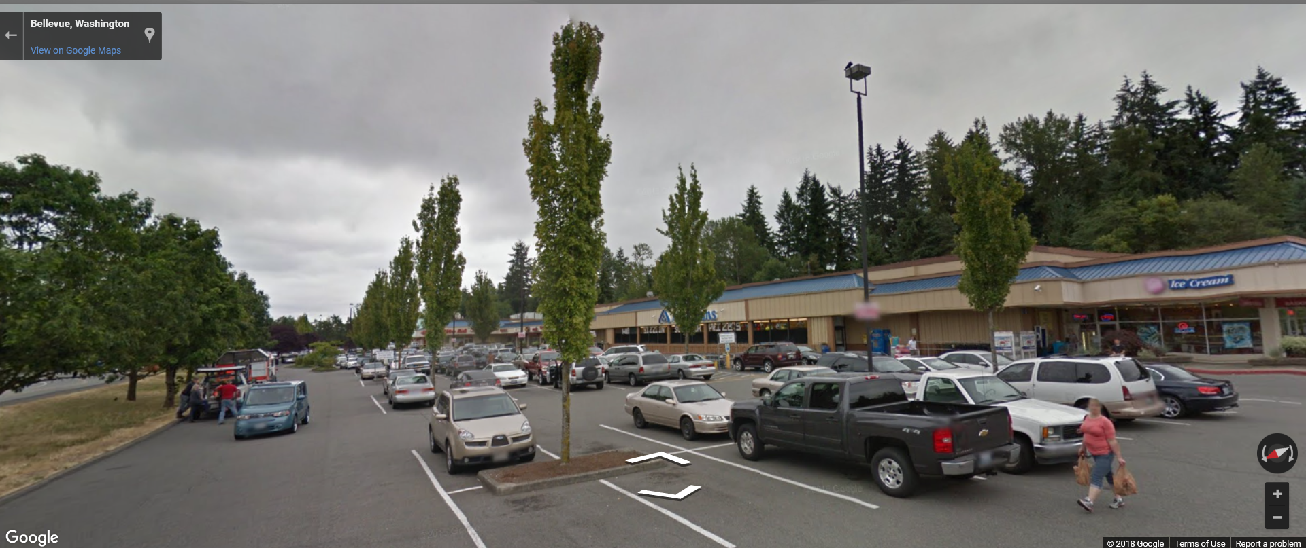
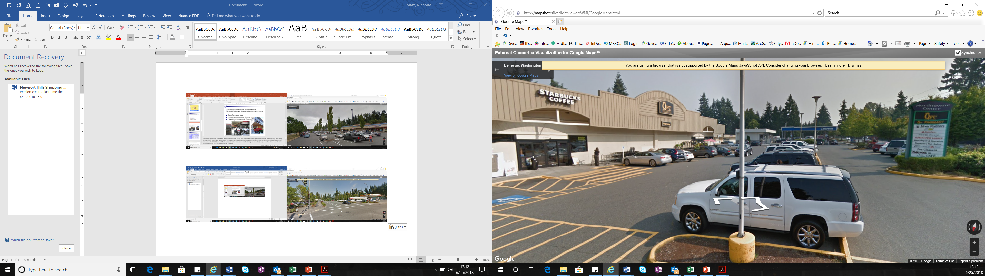
2018 Annual Comprehensive Plan Amendments
Threshold Review and Geographic Scoping Public Hearing
Aging Commercial Areas
Neighborhood Commercial Centers
Adaptability (Neighborhoods Element)

Slide 11
2018 Annual Comprehensive Plan Amendments
Threshold Review and Geographic Scoping Public Hearing
Neighborhood Mixed Use (NMU) – A land use designation that provides for a mix of retail, service, office, and residential uses, with an emphasis on neighborhood retail and service uses. This district is designed to be compatible with nearby residential neighborhoods and to be easily accessible from the nearby office and residential uses that it serves.
Neighborhood Business (NB) — A retail land use designation that provides for the sale of convenience goods and personal services for the day-to-day needs of the immediate neighborhood. These sites may also accommodate a limited amount of administrative office space, provided the office use does not interfere with the site’s primary neighborhood serving function.
Newport Hills Subarea Plan General Land Use
The Newport Hills commercial district provides goods and services for the neighborhood, and is also the community’s focal point. Both functions may be enhanced in the future through greater communication and cooperation between business owners and residents. Redevelopment opportunities in the Newport Hills commercial district could include a mixed-use component where retail and housing are integrated. Introducing housing to this neighborhood business area may help support a greater variety of retail uses.

Slide 12
2018 Annual Comprehensive Plan Amendments
Threshold Review and Geographic Scoping Public Hearing
Application | Proposal | Date | Outcome
Newport Hills Subarea | Plan adoption | October 1994 | Resolution 5823
West Ravine | SF-L to SF-UR and SF-H | October 1995 | Ordinance 4803
Olson Coal Creek | SF-M to MF-M | December 1998 | Ordinance 5118
Wittman Open Space | Open Space Taxation designation | May 1998 | Withdrawn
The Oaks | Delete trail requirement | December 1998 | Denied
113th Pl SE | West Ravine SF-UR to O | December 2001 | Denied
Dana | SF-H to MF-L | October 2003 | Denied
Lakevue Luxury Storage | West Ravine SF-UR to LI | April 2004 | Withdrawn
Newport Hills Village | NB to MF-M and NB | June 2016 | Withdrawn
Newport Hills Shopping Center Redevelopment | NB to NMU | January 2018 | In Review

Slide 13
2018 Annual Comprehensive Plan Amendments
Threshold Review and Geographic Scoping Public Hearing
Public Comment
Hundred Fifty Eight (June 27)
Not in favor
In favor
Core refrain

Slide 14
Newport Hills Shopping Center Redevelopment
Staff Recommendation
Meets Threshold Review
Include in Work Program
Addresses significantly changed conditions since the last time the pertinent Comprehensive Plan map or text was amended: unanticipated consequences of NB land use designation as revitalization tool: not addressing new housing, sustaining local business, maintaining “third place” role in community.
Consistent with current general policies for aging commercial areas, neighborhood commercial centers, and adaptable neighborhoods in Land Use, Neighborhoods, and Economic Development policies and in Newport Hills Subarea policies.

Slide 15
2018 Annual Comprehensive Plan Amendments
Threshold Review and Geographic Scoping Public Hearing
When is a significantly changed condition “significant?”
Significantly changed conditions
Demonstrating evidence of change such as: CONTEXT OF ISSUE
unanticipated consequences of an adopted policy, or | ← CHOOSE ONE AND APPLY IT TO ↓
changed conditions on the subject property or its surrounding area, or
changes related to the pertinent Plan map or text;
where such change has implications of a magnitude that need to be addressed for the Comprehensive Plan to function as an integrated whole.

Slide 16
2018 Comprehensive Plan Amendments
Threshold Review and Geographic Scoping
Bellevue Planning Commission
Threshold Review June 27, 2018
Nicholas Matz AICP Terry Cullen AICP

