Slide 1
2018 Comprehensive Plan Amendments
Threshold Review and Geographic Scoping
Bellevue Planning Commission
Threshold Review Public Hearings June 13, 2018
Nicholas Matz AICP Terry Cullen AICP

Slide 2
2018 Annual Comprehensive Plan Amendments
Threshold Review and Geographic Scoping Public Hearing
The Comprehensive Plan is Bellevue’s foundational policy document…an amendment to the Plan is a mechanism by which the City may modify its land use, development or growth policies.
Land Use Code (LUC) 20.30I.120 – Purpose
Overview of the review process:
Limited to an annual process under GMA
Threshold Review recommendations =
  proposed annual work program
Annual work program established when City Council acts on Planning Commission recommendations (July)

Slide 3
2018 Annual Comprehensive Plan Amendments
Threshold Review and Geographic Scoping Public Hearing
Planning Commission tonight:
Conduct a Threshold Review public hearing for each proposed amendment
Conduct a study session following each public hearing to make a recommendation
Continue to conduct real-time auditing of tonight’s material and process

Slide 4
DASH Glendale
City Dacha LLC
Bellevue Nursery
Red Town
Newport Hills SC Redevelopment

Slide 5
2018 Comprehensive Plan Amendments
Threshold Review and Geographic Scoping
City Dacha LLC
Threshold Review Public Hearing

Slide 8
City Dacha LLC
Staff Recommendation
Meets Threshold Review
Include in Work Program
Addresses significantly changed conditions since the last time the pertinent Comprehensive Plan map or text was amended: unanticipated consequences of Public designation of the site (P/SF-L).
Since the site will not be acquired for park purposes, the designation is an unintended consequence in that it prevents consideration of the appropriate density on this site.
Development of area surrounding the site under Wilburton Subarea policy frames this question, and not the zoning or rate of growth.

Slide 9
2018 Annual Comprehensive Plan Amendments
Threshold Review and Geographic Scoping Public Hearing
Public Comment
None to date

Slide 10
2018 Comprehensive Plan Amendments
Threshold Review and Geographic Scoping
City Dacha LLC
Threshold Review Study Session

Slide 11
2018 Annual Comprehensive Plan Amendments
Threshold Review and Geographic Scoping Public Hearing
Single-family Low-density (SF-L) — A residential land use designation allowing up to 1.8 dwelling units per acre.
Minimum lot size R-1 zone = 35,000 s.f.
Public Facilities (PF) — A land use designation suffix that recognizes use by public facilities that serve the general public or provide public benefit, such as…park and recreational facilities…Public facilities are fixed assets.
Multifamily Medium-density (MF-M) — A residential land use designation allowing from 11 to 20 dwelling units per acre.
Minimum lot size R-20 zone = 8,500 s.f.

Slide 12
2018 Comprehensive Plan Amendments
Threshold Review and Geographic Scoping
Bellevue Nursery
Threshold Review Public Hearing

Slide 15
Bellevue Nursery
Staff Recommendation
Meets Threshold Review
Include in Work Program
Addresses significantly changed conditions since the last time the pertinent Comprehensive Plan map or text was amended: unanticipated consequences of a residential land use designation directing redevelopment, that conflicts with reality of the site’s extremely long-tenured use for commercial purposes.
The nonconforming designation prevents the site from sustaining its community role.
The nursery is a business that is an anchor of the local community. It’s role as a “third place” is in conflict with the Plan designation for the site as residential.

Slide 17
2018 Annual Comprehensive Plan Amendments
Threshold Review and Geographic Scoping Public Hearing
Public Comment
Four comments or inquiries from four parties of interest received.
Themes:
  Specific objections that 1) the application did not address significantly changed conditions and 2) nothing has changed for the site and business as long as it has been there.

Slide 18
2018 Comprehensive Plan Amendments
Threshold Review and Geographic Scoping
Bellevue Nursery
Threshold Review Study Session

Slide 19
2018 Annual Comprehensive Plan Amendments
Threshold Review and Geographic Scoping Public Hearing
Single-family High-density (SF-H) — A residential land use designation allowing up to 5 dwelling units per acre.
Minimum lot size R-4 zone = 8,500 s.f.
Neighborhood Business (NB) — A retail land use designation that provides for the sale of convenience goods and personal services for the day-to-day needs of the immediate neighborhood. These sites may also accommodate a limited amount of…office… provided the office use does not interfere with the site’s primary neighborhood serving function.
Minimum lot size = no minimum

Slide 20
2018 Comprehensive Plan Amendments
Threshold Review and Geographic Scoping
Red Town
Threshold Review Public Hearing

Slide 23
Red Town
Staff Recommendation
Meets Threshold Review
Include in Work Program
Addresses significantly changed conditions on the subject property or its surrounding area: implications needing addressed for the Plan to function as an integrated whole.
Lakemont-area neighborhoods built out at densities supporting the infrastructure intended for these levels of urban development. Policy focusing on this relationship is implemented on surrounding sites only--a significantly changed condition for the Red Town site.
The site is essentially overlooked, with land at a potential density that cannot take advantage of this relationship.

Slide 24
2018 Annual Comprehensive Plan Amendments
Threshold Review and Geographic Scoping Public Hearing
Public Comment
Five public comments or inquiries from five parties of interest.
The comments ask about understanding the proposal, with one noting their nearly-20,000 square foot lot size compared to the typical 4,700 square foot-plus sizes in the Albright PUD development.

Slide 25
2018 Comprehensive Plan Amendments
Threshold Review and Geographic Scoping
Red Town
Threshold Review Study Session

Slide 26
2018 Annual Comprehensive Plan Amendments
Threshold Review and Geographic Scoping Public Hearing
Single-family Medium-density (SF-M) — A residential designation allowing up to 3.5 dwelling units per acre.
Minimum lot size R-3.5 zone = 10,000 s.f.
Single-family Urban Residential (SF-UR) — A residential land use designation allowing up to 7.5 dwelling units per acre.
Minimum lot size SF-UR zone = 4,700 s.f.

Slide 27
2018 Comprehensive Plan Amendments
Threshold Review and Geographic Scoping
DASH Glendale
Threshold Review Public Hearing

Slide 30
DASH Glendale
Staff Recommendation
Include a geographically-expanded site in the previously established Wilburton Citizen Advisory Committee Study work program recommendation.
Direct Wilburton Study policy, code, and zoning implementation work to establish land use and density for the site consistent with Wilburton CAC vision and principles.
Wilburton CAC agreed to recommend including the site in the Study Area by identifying it in its project principles framework for affordable housing—unique opportunity created by a remarkable intersection of city affordable housing strategy implementation, DASH provider goals, and appropriate and related land uses in Wilburton.
Proposed use of the Neighborhood Mixed Use (NMU) designation to address DASH and citywide affordable housing strategy implementation presents a reason to examine under Threshold Review, but…
Including this site in the Wilburton work program will make it part of Affordable Housing Strategy implementation work identifying the site’s capacity for affordable housing.

Slide 31
2018 Annual Comprehensive Plan Amendments
Threshold Review and Geographic Scoping Public Hearing
Public Comment
Eight public comments or inquiries from six parties of interest.
Information; concern about measuring how density could occur on the site; support.
Comments by Wilburton CAC members about how to apply height and FAR dimensions being developed for the residential land use areas in Wilburton.

Slide 32
2018 Comprehensive Plan Amendments
Threshold Review and Geographic Scoping
DASH Glendale
Threshold Review Study Session

Slide 33
2018 Annual Comprehensive Plan Amendments
Threshold Review and Geographic Scoping Public Hearing
Multifamily Medium-density (MF-M) — A residential land use designation allowing from 11 to 20 dwelling units per acre.
Minimum lot size R-20 zone = 8,500 s.f.
Neighborhood Mixed Use (NMU) – A land use designation that provides for a mix of retail, service, office, and residential uses, with an emphasis on neighborhood retail and service uses. This district is designed to be compatible with nearby residential neighborhoods and to be easily accessible from the nearby office and residential uses that it serves.

Slide 34
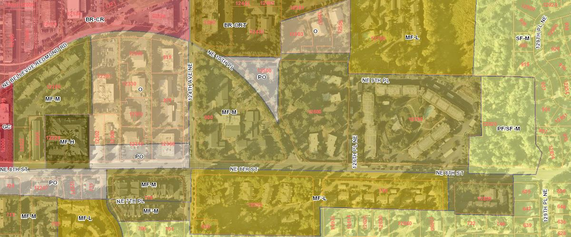

Slide 35
2018 Annual Comprehensive Plan Amendments
Threshold Review and Geographic Scoping Public Hearing
When is a significantly changed condition “significant?”
Significantly changed conditions
Demonstrating evidence of change such as: CONTEXT OF ISSUE
unanticipated consequences of an adopted policy, or | ← CHOOSE ONE AND APPLY IT TO ↓
changed conditions on the subject property or its surrounding area, or
changes related to the pertinent Plan map or text;
where such change has implications of a magnitude that need to be addressed for the Comprehensive Plan to function as an integrated whole.

Slide 36
2018 Comprehensive Plan Amendments
Threshold Review and Geographic Scoping
Bellevue Planning Commission
Threshold Review June 13, 2018
Nicholas Matz AICP Terry Cullen AICP

