Slide 1
2018 Comprehensive Plan Amendments Final Review
Bellevue Planning Commission
Final Review Public Hearings November 7, 2018
Emil King AICP, Terry Cullen AICP

Slide 2
2018 Annual Comprehensive Plan Amendments Final Review Public Hearing
The Comprehensive Plan is Bellevue’s foundational policy document…an amendment to the Plan is a mechanism by which the City may modify its land use, development or growth policies.
Land Use Code (LUC) 20.30I.120 – Purpose
Overview of the review process:
Limited to an annual process under GMA
Final Review recommendations → City Council action
Environmental impacts examined on entirety of work program

Slide 3
2018 Annual Comprehensive Plan Amendments Final Review Public Hearing
Planning Commission tonight:
Conduct a Final Review public hearing for each of the two City Council-initiated proposed amendments
Conduct a study session following each public hearing to make a formal recommendation to City Council
Continue to conduct real-time auditing of tonight’s material and process

Slide 4
Grand Connection
East Main

Slide 5
2018 Comprehensive Plan Amendments Final Review
Grand Connection
Final Review Public Hearing

Slide 6
Notes:
Refer to policies and map amendment pieces in staff report

Slide 7
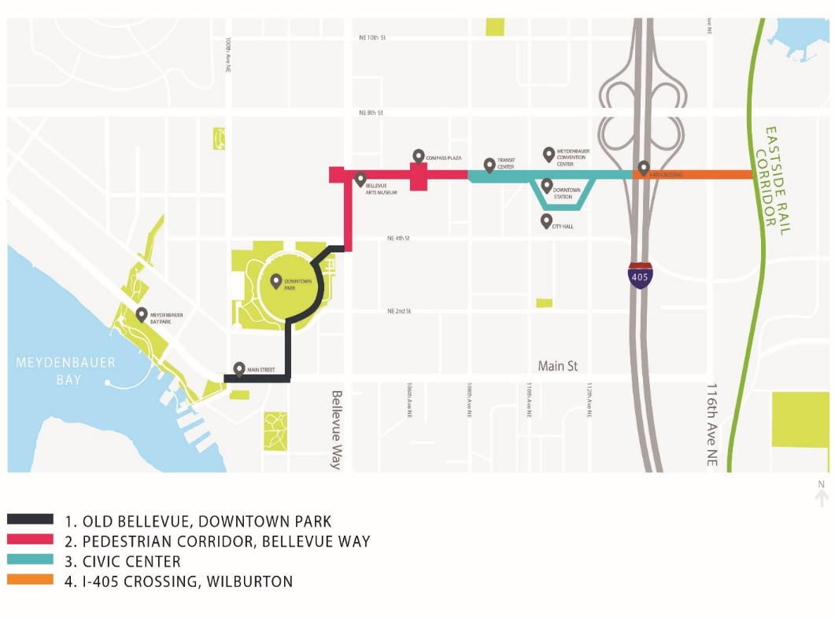
Grand Connection
Staff Recommendation
Meets Final Review
Approve
Consistent with the Comprehensive Plan
Addresses interests and changed needs of the entire city
Addresses significantly changed conditions
Demonstrates public benefit and enhances the public health, safety, and welfare

Slide 8
Grand Connection Final Review Public Comment
General support for Grand Connection policies during Commission process to date
Ongoing Public Engagement
Project website
Community meetings
Stakeholder worksessions

Slide 9
Grand Connection Plan Amendment Next Steps
Sequence One: changes and improvements to existing infrastructure between 100th Avenue NE/Main Street and the Civic Center District.
Land Use Code Amendment (LUCA)
Design Guidelines development
Sequence Two:
I-405 crossing/interface with:
Downtown
Wilburton Commercial Area future vision (2019)
Eastside Rail Corridor

Slide 10
2018 Comprehensive Plan Amendments Final Review
Grand Connection
Threshold Review Study Session

