Slide 1
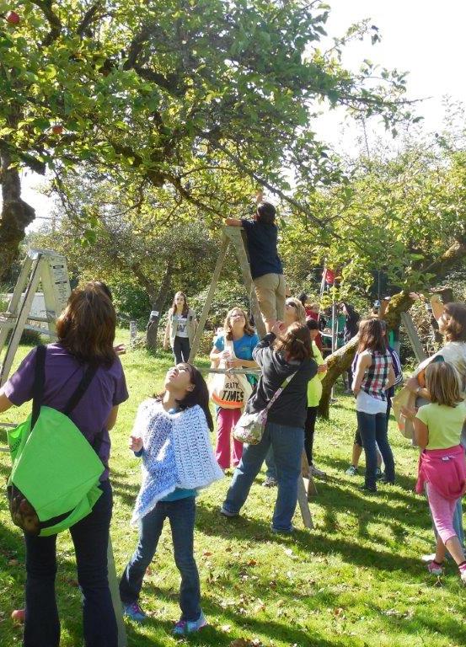
Continued Discussion of Initiation of the Neighborhood Area Planning Program
Mac Cummins
Terry Cullen
Mike-McCormick-Huentelman
Deborah Munkberg
July 9, 2018

Slide 2
Direction Requested
Whether to:
Continue to move forward with initiation of neighborhood area planning
Bring forward for Council review options for an approach to neighborhood planning sequencing
Notes:
May 29 – presented overview of the proposed NAP, took notes on Council direction and comments; also described June 12 neighborhood leaders forum – bringing back responses to comments and input from the June 12 meeting.
Seeking direction on moving forward with initiation of NAP and bringing forward to Council options for an approach to neighborhood area planning sequencing

Slide 3
Neighborhood Area Planning
process overview
1 year planning process; 2 plans per year
Collaborative, inclusive engagement
Organic planning process
Strategic and future focused
Notes:
Short summary of the process that staff is proposing and presented to Council on May 29 and to the neighborhood leaders on June 12
One year time frame, two per year
We want to provide space and room to allow for meaningful participation and conversations. On balance, proposing a one year work program, with two plans per year.
Schedule that would allow the more active neighborhood parts of the planning process to happen during the school year, so roughly September through June
Discovery – a chance to share information, have a two-way conversation about what is important to residents in the NA and for city representatives to share citywide priorities. Start on identification of priorities that we should be focusing on in the next phase of work.
Refine and develop priorities – Roll up the sleeves work sessions to turn preliminary ideas/priorities into more developed strategies and actions. Discussion circles, city staff as subject matter experts and trained citizen facilitators as we move forward. Also an opportunity for a tactical urbanism project – which is essentially short demonstration project in the neighborhood to test concepts. Outcome will be the draft strategies and actions for community discussion.
Review and validation – opportunity to broadly engage with the community to confirm understandings, resolved outstanding issues, and achieve agreement on draft strategies. Outcome will be the draft NAP.

Slide 4
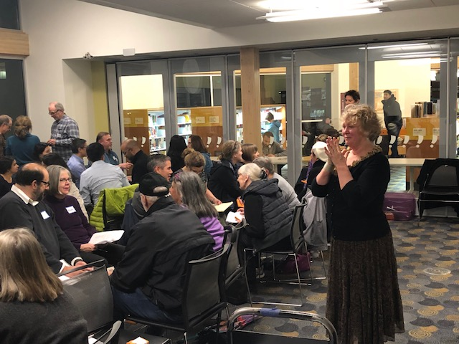
Neighborhood Leaders Forum
June 12, 2018
Notes:
Neighborhood Leaders Forum on June 12
Attended by about 40 members of the public
Shared conversation – opportunities for residents to share what is important about their neighborhood area; a chance for staff to describe the proposed program; and a discussion feedback, any words of advice

Slide 5
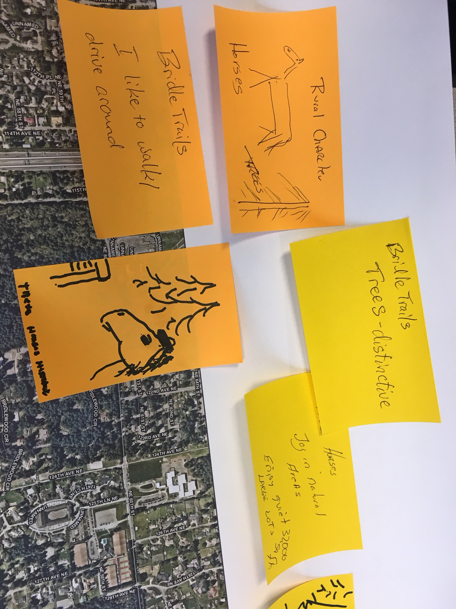
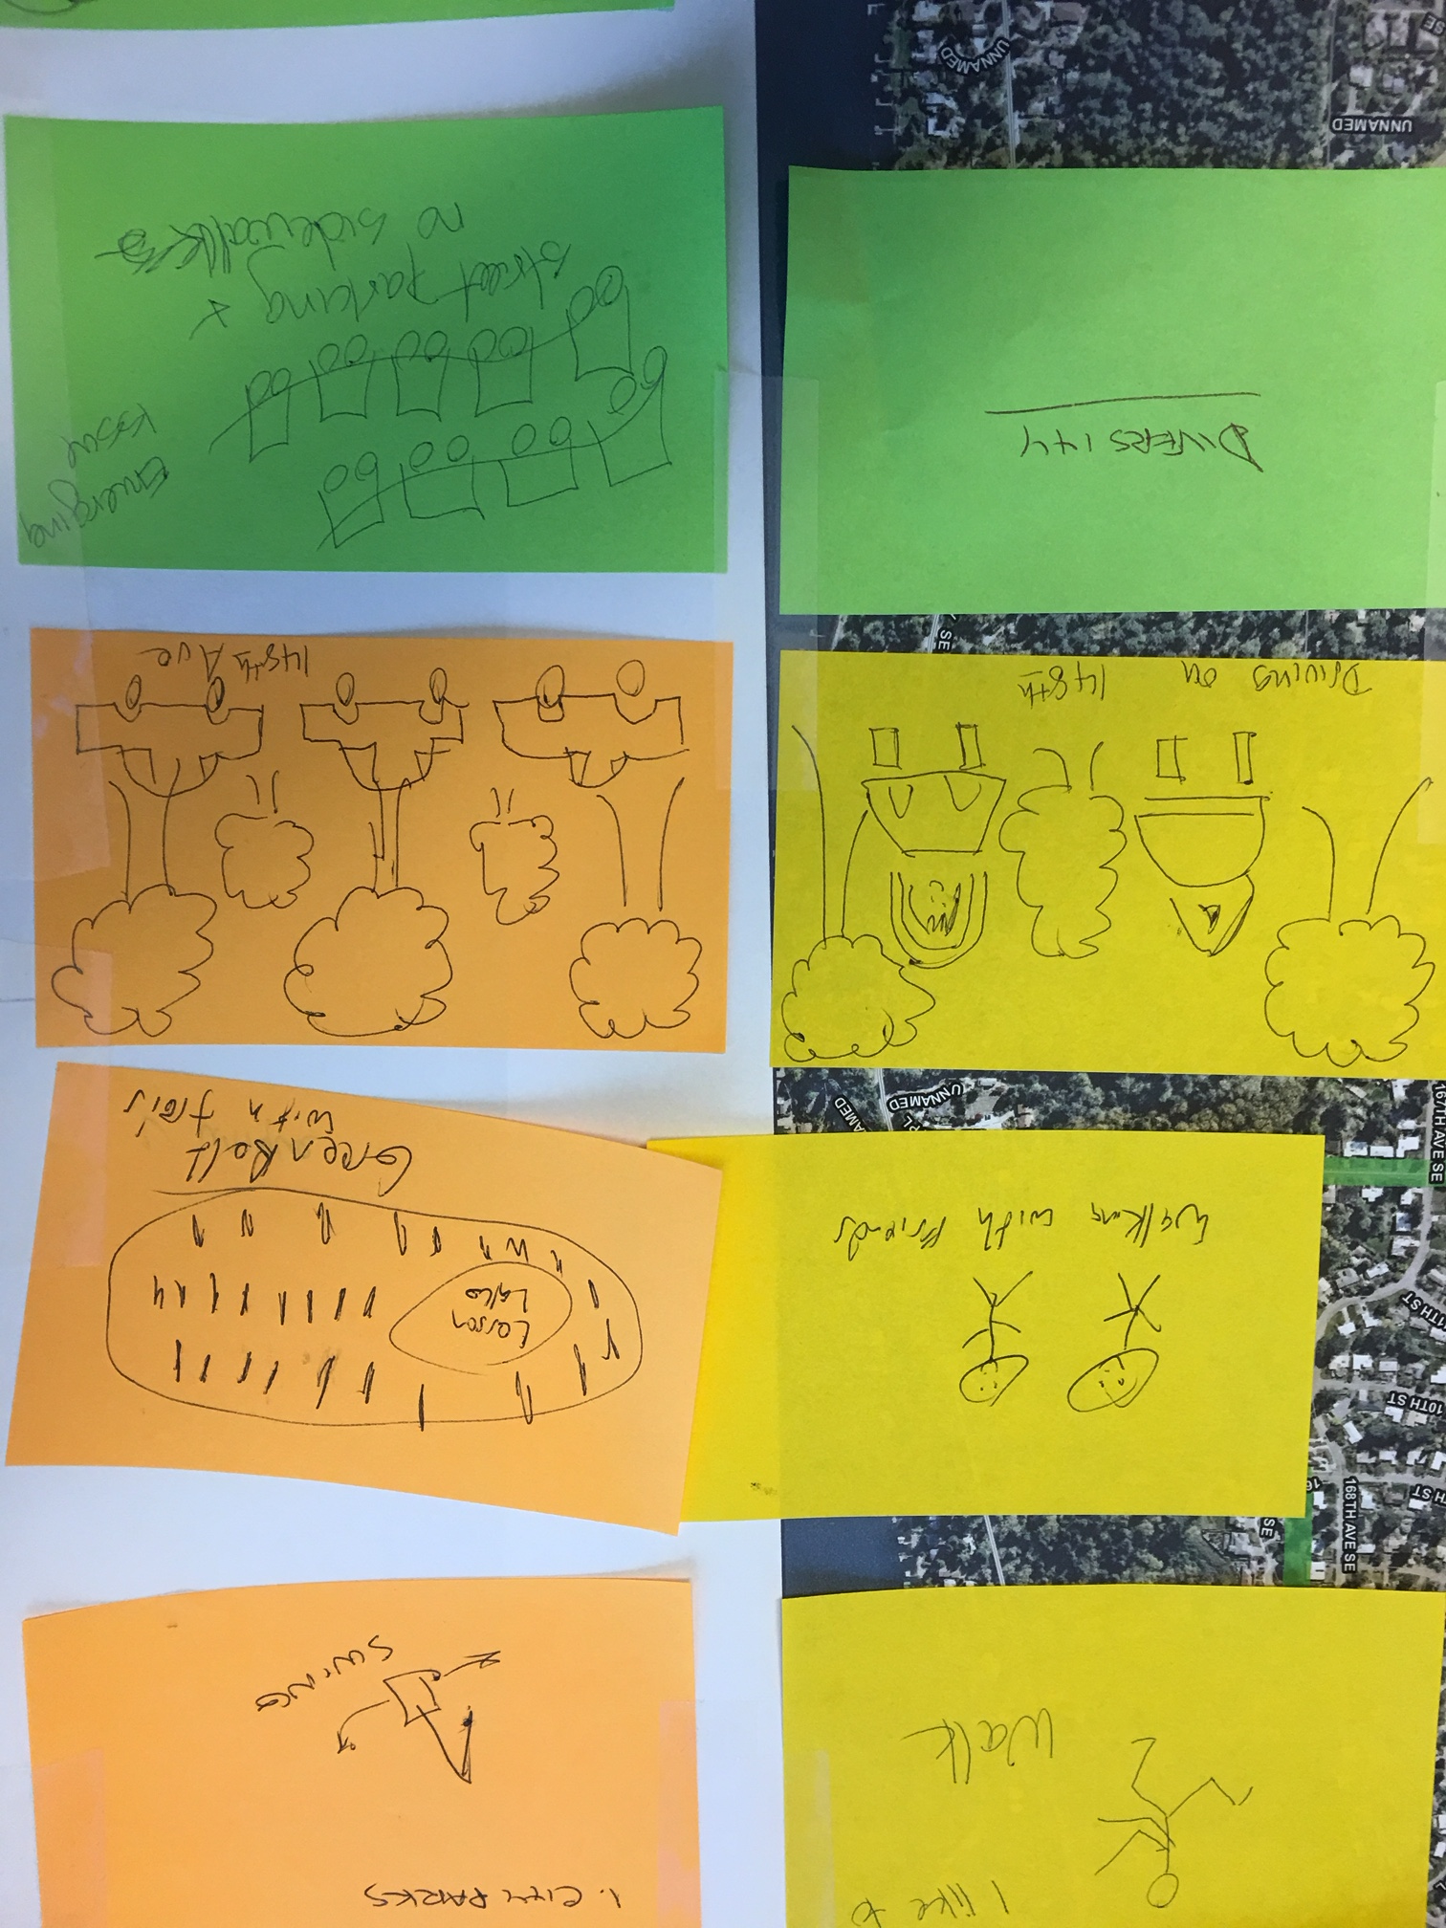
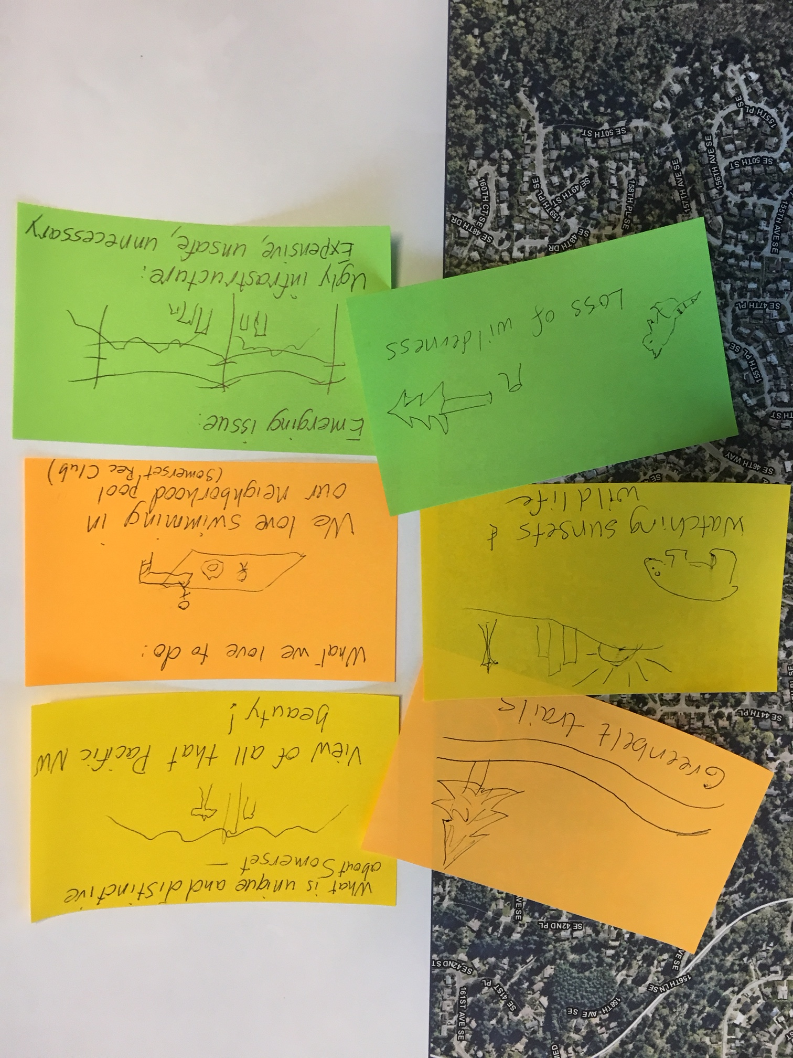
Neighborhood Leaders Forum
neighborhood area maps
Notes:
Answer three questions:
What makes your neighborhood unique and distinctive
What do you like to do in your neighborhood
What emerging issues do you see in the future for your neighborhood
Illustrate responses; spend a little time with your neighborhood area map, meet others in your area and talk about your responses. Shared with group as a whole
Big picture themes – character, sense of neighborliness, parks/open space, trees are what make neighborhoods unique
People like to walk, use parks, appreciate nature
Emerging issues – traffic (congestion and safety) and how growth is impacting their neighborhood

Slide 6
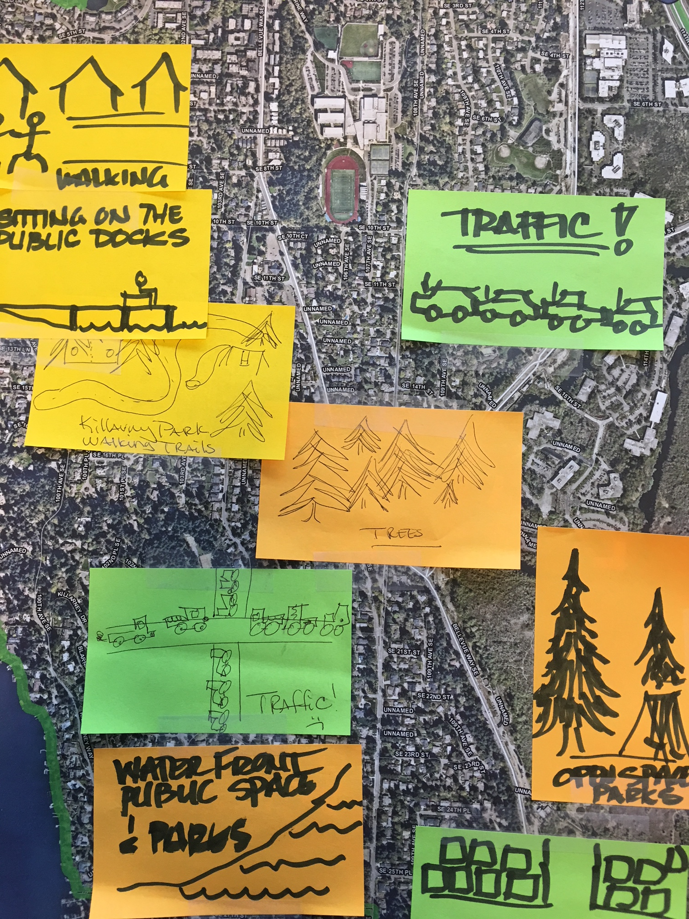
public engagement
Neighborhood Leaders Forum
Engage with youth
Schools
Inclusive outreach
Share stories
Barriers to participation
Community events
Meaningful use of time
Notes:
Discussion was positive – good ideas, questions
Many ideas, all good and will be incorporated into the process
Inclusive – language and people
Schools – as meeting places, public/private, as a way to bring in youth to the process
Shared training – looking for opportunities to provide broader training about the city – shared between first two neighborhoods, larger groups
Faith-based organizations – bring in faith based organization
Story-telling – bringing personal stories that are part of why neighborhoods are distinct and unique and also bring a sense of history
Remove barriers – childcare, multiple venues, times and days, ways to participate

Slide 7
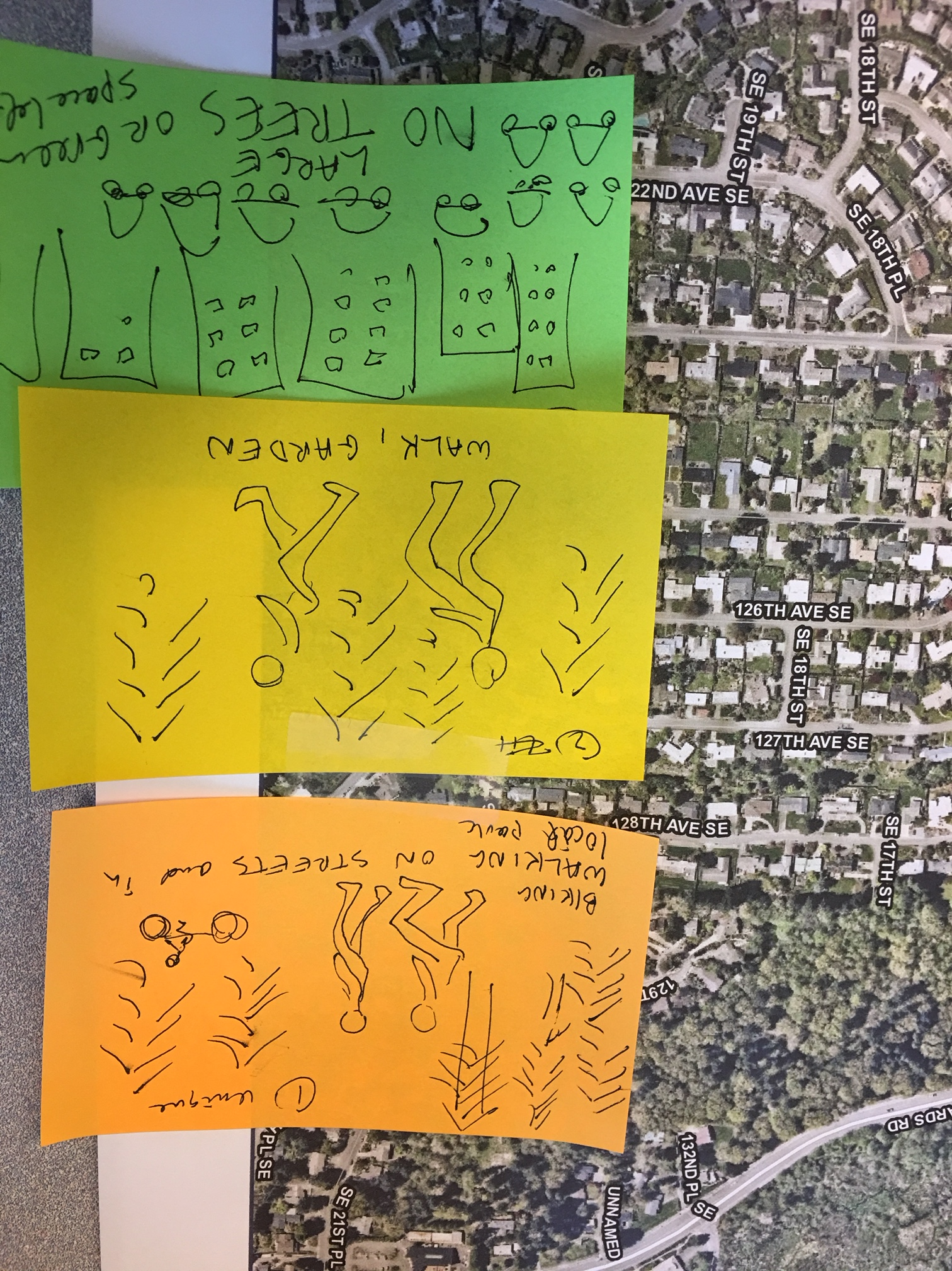
Neighborhood Leaders Forum
planning process
Kick-off packet
Build from existing plans
Shared training
Notes:
Also talked about process
Kick-off packet – brief overview of cp; capital investments in neighborhood; programs applicable to the neighborhood area
Breakdown of the existing plans – what was important 15 or 20 years ago, is it still important? What has changed and
Shared training – 101 on comprehensive plan, how to engage

Slide 8
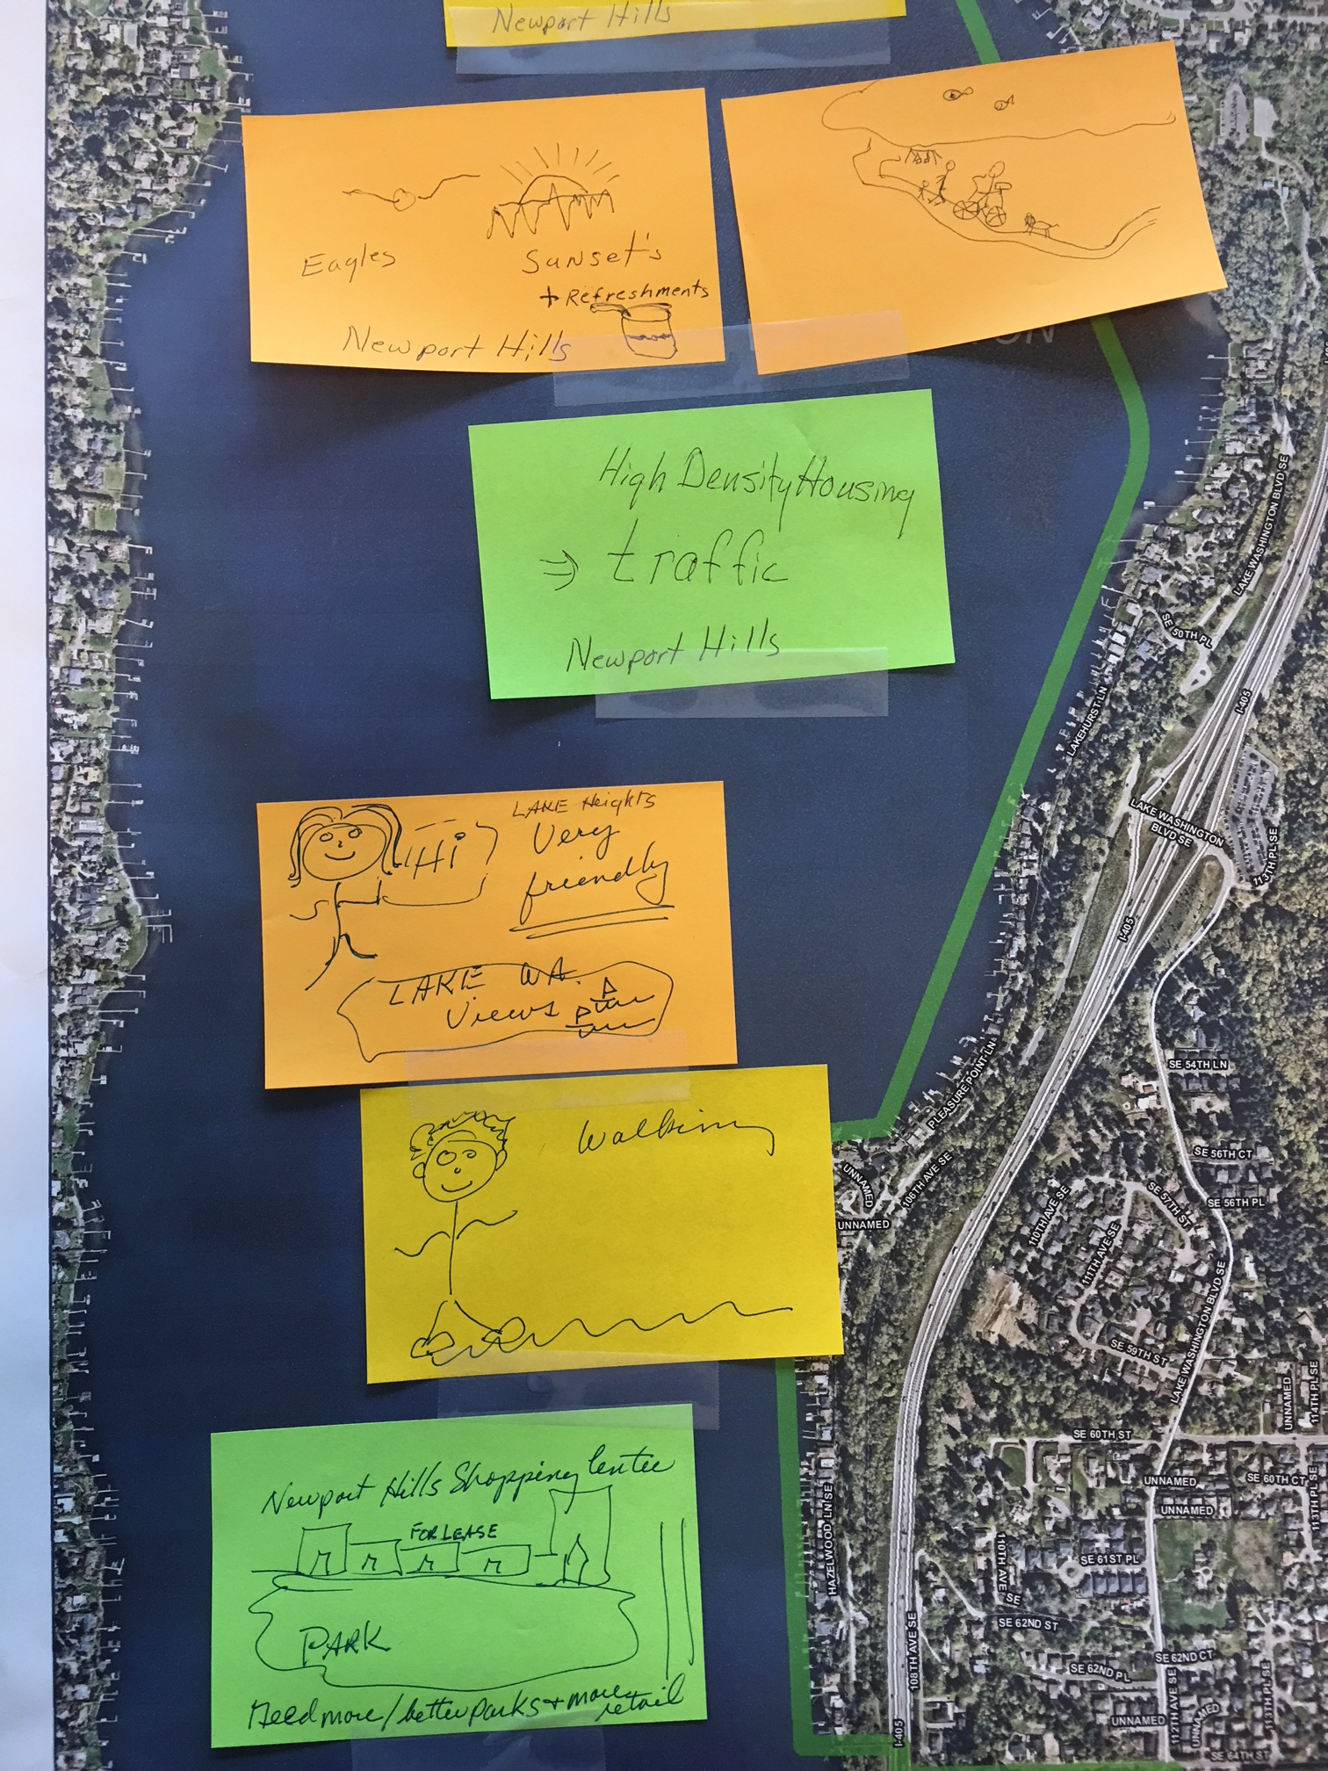
Neighborhood Leaders Forum
plan sequence
Shared boundaries
Urgent issues
Don’t force solutions that don’t fit
Notes:
Considerations:
Shared boundaries – might be more efficient and potential to have common issues
Where there are inherent dependencies – primarily residential neighborhood that might depend on commercial services
Think about where are the most urgent issues
Don’t over-combine – make sure that we remember that this process is intended to recognize the unique and distinctive character of our neighborhoods and we don’t want to force a process that doesn’t recognize that in the interest of trying to move more quickly

Slide 9
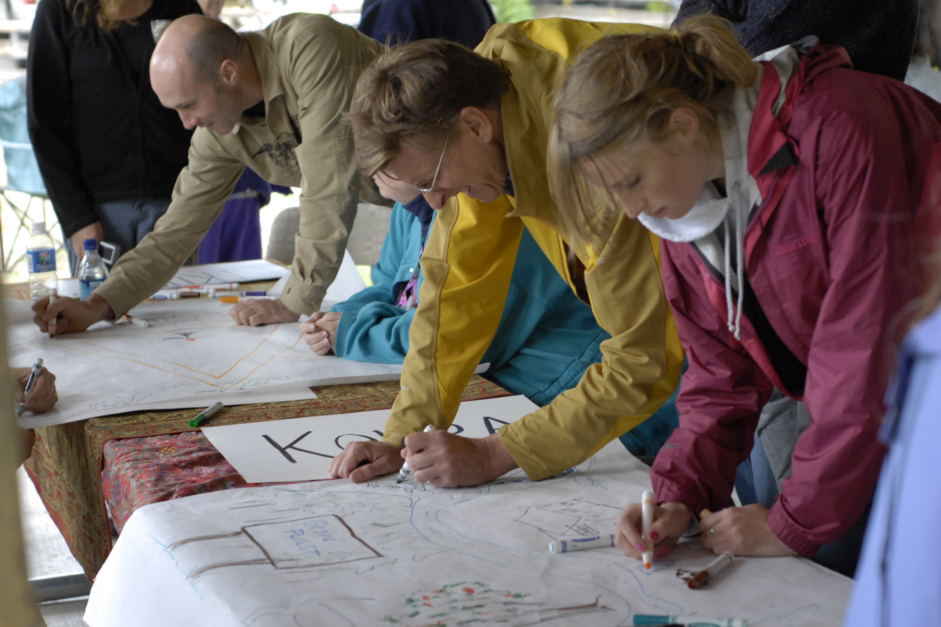
City Council Comments
public engagement
Inclusive
Collect contact information for future notice
Include local businesses
Cross neighborhood boundaries
Skills and training
Notes:
Inclusive – addressed using our full menu of reaching out to people – social media, traditional methods, looking for ways to reach to different cultural groups, schools,
Tracking contact information so that we can make sure that people continue to be notified over the course of the process
Looking for ways to include local businesses – such as providing special times/days that are more convenient for business owners, as well as inclusion in the broader outreach process
Neighborhood boundaries – making sure that we recognize interests of adjoining areas; but also recognize that the voices of those in the neighborhood area will carry the greatest weight; and tracking issues that cross boundaries are preserved
Skills and training – weaving into the planning process opportunities for helping people and the neighborhood area to expand capacity for working together effectively, finding solutions, and making effective decisions.
Appreciate these comments and wholeheartedly intend to bring into the process. Most comments about public engagement from Council and from the neighborhood forum – We are excited about the opportunity to partner with neighborhoods in a very full and multi-faceted way. Partner because recognize limit on what we can do internally and hope to work with each neighborhood to expand our reach with their help.

Slide 10
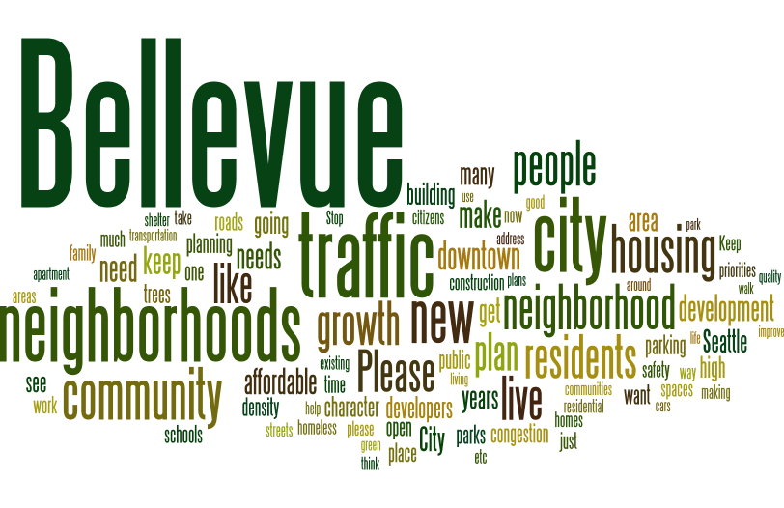
City Council
Comments
plan content
Vision and identity statements
Possible plan topics
Flexibility for plan and regulatory changes
Notes:
With respect to comprehensive plan and regulatory flexibility, clarify
the city’s fundamental vision and direction as expressed in the City Council’s vision and the Comprehensive Plan provide a framework and guide that should not vary between neighborhood areas. This includes:
Values of stewardship, innovation, and integrity
Vision: we welcome the world, diversity is our strength, we embrace the future while respecting our past.
Comprehensive Plan vision, including the following themes: diverse and vibrant neighborhoods, meeting the housing needs of a diverse population, reliable and predictable transportation system, hub for global business and innovation, stewardship of the environment, active and engaged citizenry; a community that cares; "city in a park"
Citywide growth strategy as established in the Comprehensive Plan
Standards for provision of basic city services, such as for transportation, parks, utilities, police, fire and other basic city services
Within this framework, potential plan or regulatory changes may be appropriate. An example of this type of change could include a plan amendment to reflect a neighborhood area decision related to detached accessory dwelling units, environmental stewardship or other similar neighborhood-focused topic.

Slide 11
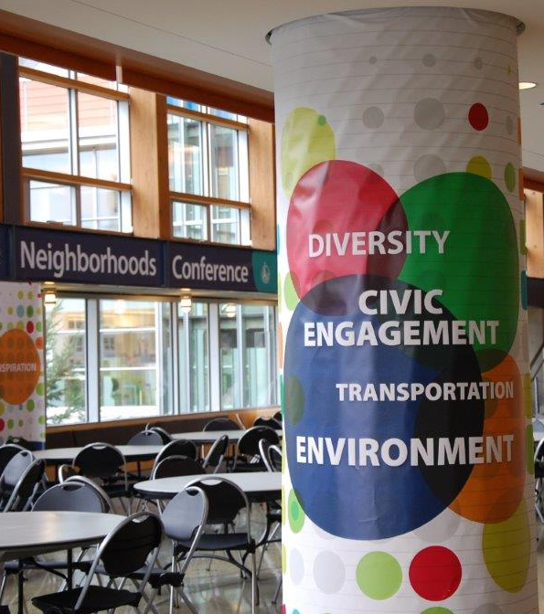
City Council
Comments
planning process
Program schedule
Potential to consolidate areas
Flexibility to address common issues
Council and Commission participation
Notes:
the proposed schedule of two plans per year is intended to provide a balance that allows for inclusive and meaningful participation while moving as quickly and efficiently as possible.
On average, neighborhood areas have a population of about 9,000, rising to 17,000 persons in the largest area. Combining neighborhood areas with relatively large population or geographic area could make it difficult to achieve our engagement goals within our time frame. However, there may be opportunities to combine areas with relatively small populations or geographic area.
As planning proceeds, there may be circumstances that would allow similar solutions to be applied to multiple areas. Staff proposes to continue to explore these opportunities and work with Council to expedite the planning process wherever possible.
Multiple ways to engage with the city outside of neighborhood planning
We recommends regular briefings to share status and progress, direction and issues to the Council and Commission rather than direct participation in events. Specific meetings that would be most informative and conducive for Council or Commission participation could also be identified.

Slide 12
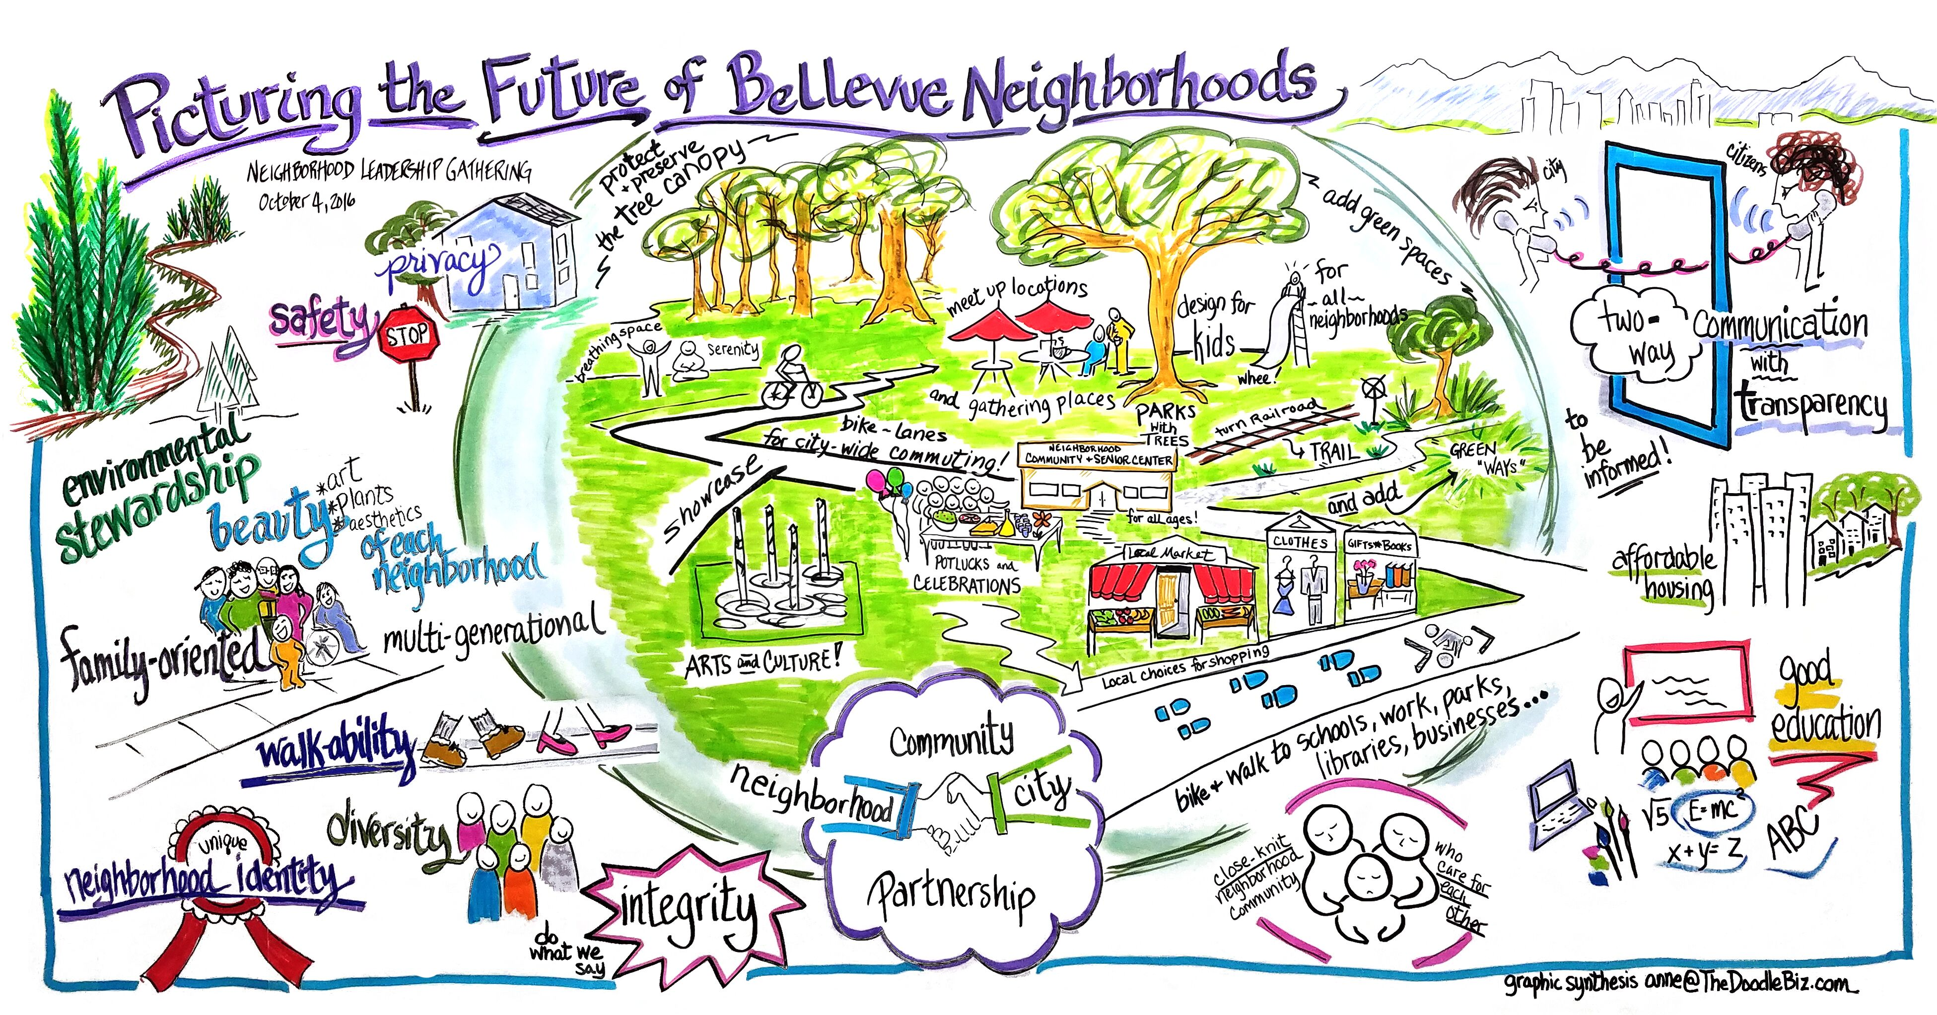
Staff recommendation
next steps
Continue to move forward with initiation of neighborhood area planning
Bring forward for Council review options for an approach to neighborhood planning sequencing

