Slide 1
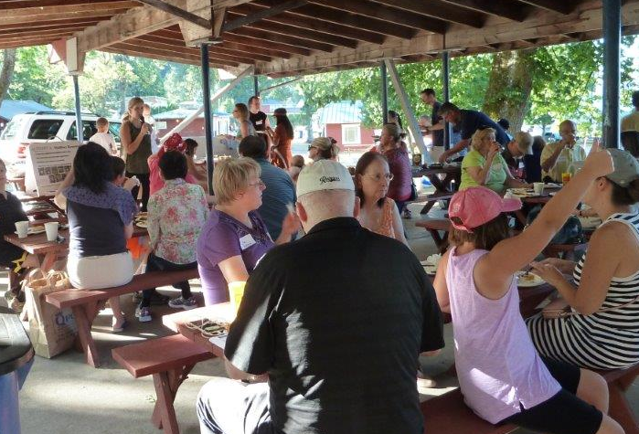
Initiating Neighborhood Area Planning
May 29, 2018
Mac Cummins, Terry Cullen,
Mike McCormick-Huentelman, Deborah Munkberg

Slide 2
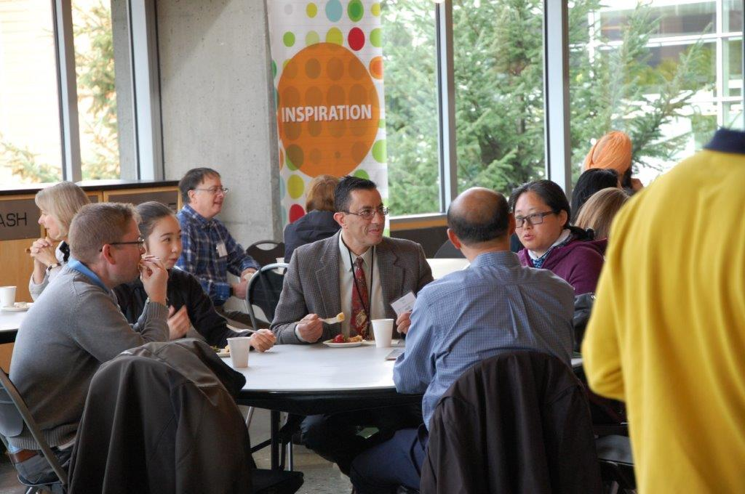
Initiating Neighborhood
Area Planning
Information only
No action requested this evening
Future presentation to seek direction from Council
Notes:
First meeting to discuss the neighborhood area planning program
No action requested
Planning to report back on June 12 neighborhood meeting and request direction from Council on next step

Slide 3
Neighborhood Area
Planning Program
Based on Comprehensive Plan
Strategic, action-focused
Ground-up community process
Notes:
Based on the Comprehensive Plan
Use a ground-up community process to get us to a strategic, action –focused plan
Will talk more about what all that means in the balance of this presentation
As developing the neighborhood planning program, used five major guide posts
Define what each plan will be and also set goals for what we hope to achieve
Would like to briefly describe each of these and how they are operationalized in the process

Slide 4
Planning and community development
Business and Industry
Place
People
Notes:
PCD manages growth by cultivating intersections between business, people and places that shape our quality of life into the future.

Slide 5
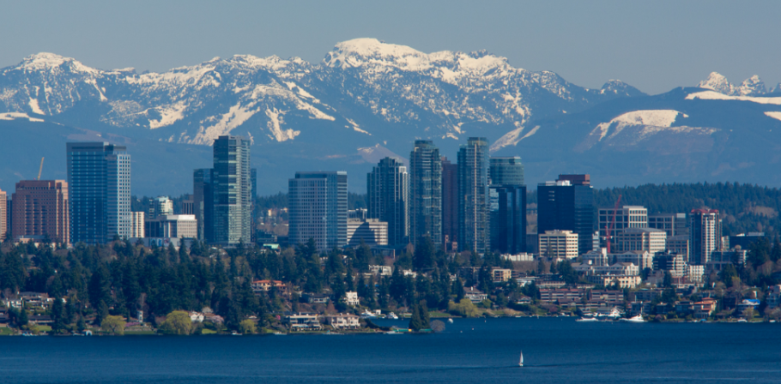
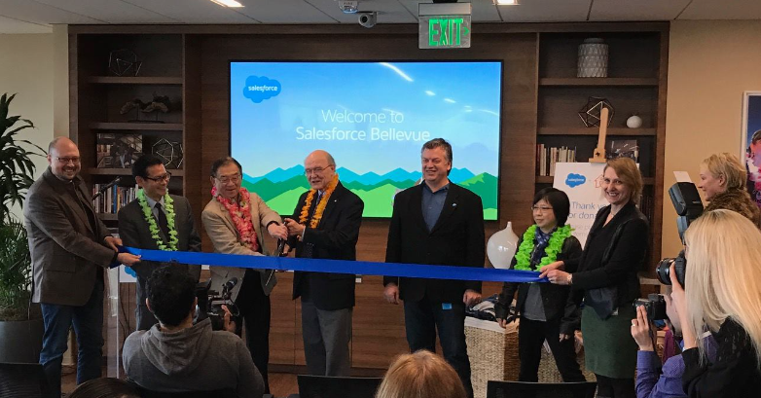



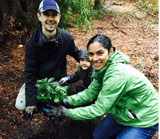
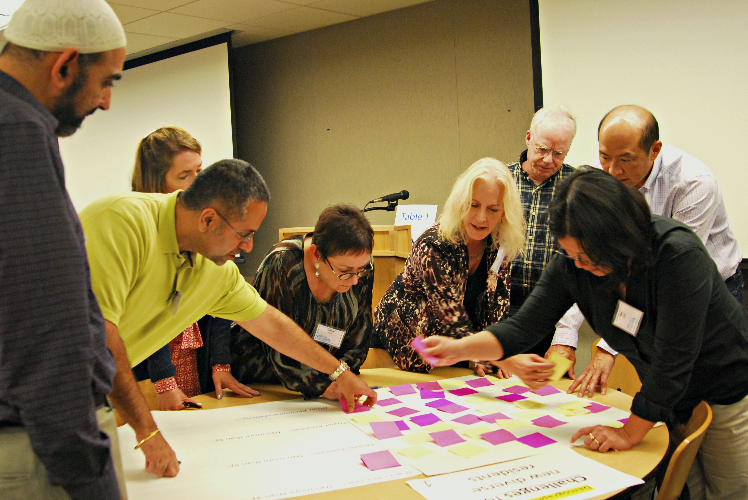


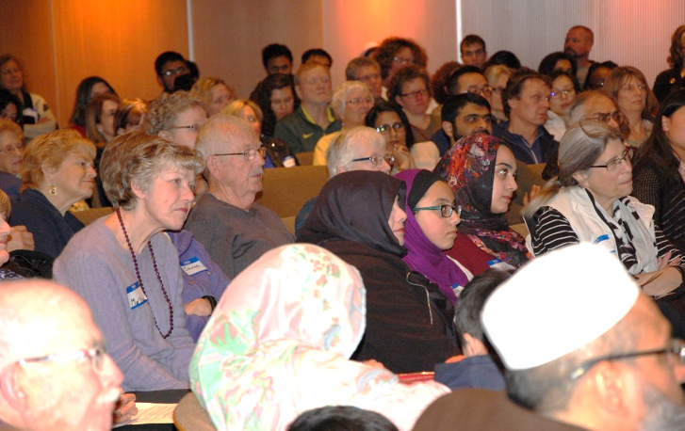
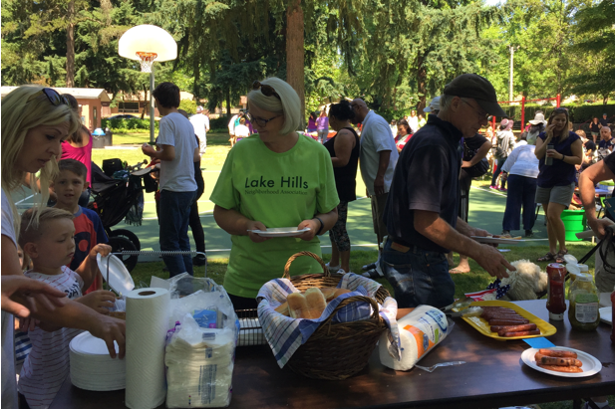
Planning and community development
Economic Development
& Arts
Housing
Neighborhood Services
Planning
Environmental Stewardship
Notes:
As a result, PCD weaves together the ongoing work of planning, economic development, arts, environmental stewardship and neighborhood services

Slide 6
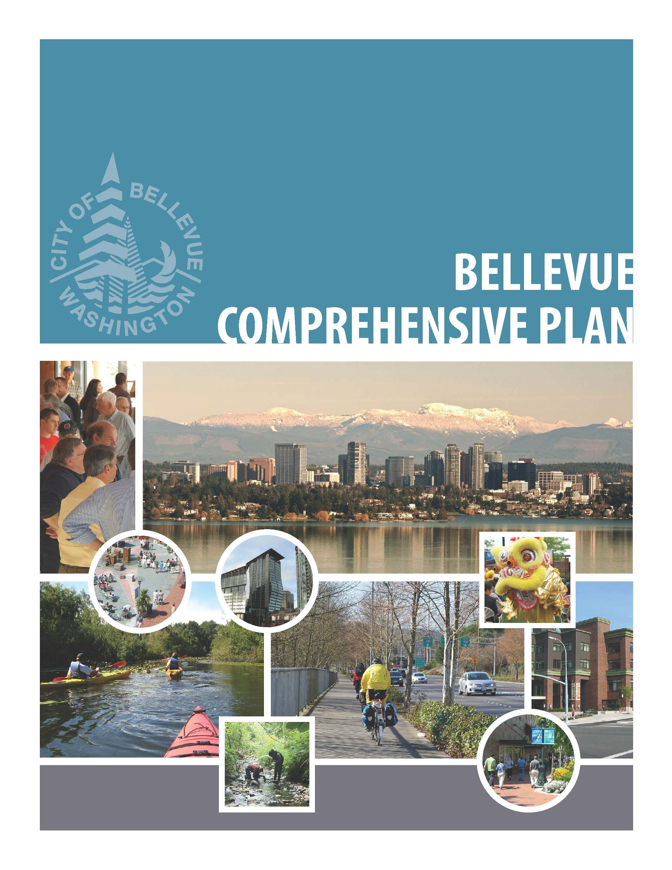
Neighborhood plans:
will be based on and part of
our Comprehensive Plan
Notes:
Guidance in our Neighborhoods Element for neighborhood area plans and citywide guidance major functions of the city – land use, housing, transportation, capital facilities, utilities, human services, parks and community services,
Part of the Comprehensive Plan – Volume 2

Slide 7
Relationship to
Comprehensive Plan
Comprehensive Plan
Volume 1
Neighborhood Area Plans
CP Volume 2
Land Use Regulations
Notes:
Will be consistent with the City’s adopted policies and regulations
Means that we will not be making major land use, transportation or other changes that would not be consistent with adopted citywide policy
Will not be changing land use designations, arterial designations
Example
tree preservation – stewardship programs, inventory
We will be reviewing the existing plans to identify outdated information and redundant policies

Slide 8
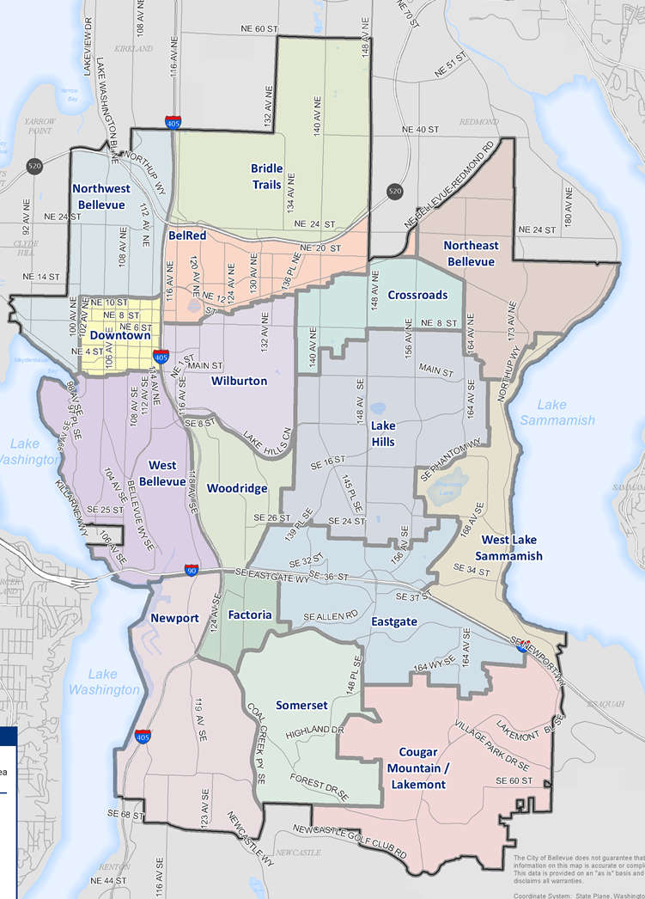
Neighborhoods Element
Establishes 16 neighborhood areas
Articulate vision
Strategies for adapting to change while preserving what is valued
Notes:
Neighborhoods Element adopted in 2015 as part of the last major cp update
Intent was twofold:
Better align neighborhood area boundaries with how people perceive their neighborhoods and to recognize topography and arterials
Policies and direction that creates a pathway to help neighborhoods envision their future and plan strategies that will help each neighborhood adapt to change while preserving what is valued

Slide 9

Neighborhood plans:
will be strategic and future-focused
Notes:
Arise from identified interests and priorities of the neighborhood area
Will include a vision for the future
Will include strategies and actions

Slide 10
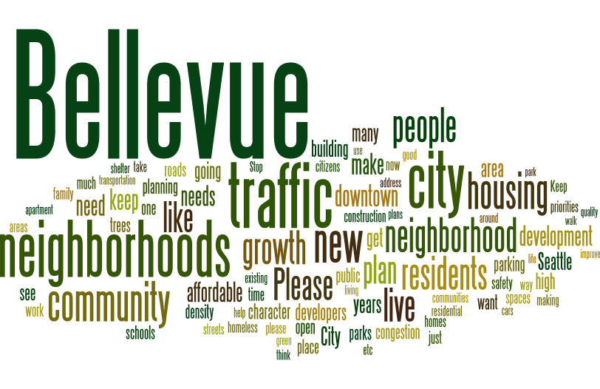
What will be in the plans?
Community profile
Opportunities map
Relationship to Comprehensive Plan
Vision and strategies
Notes:
Concise, clear, strategic, graphics and images

Slide 11
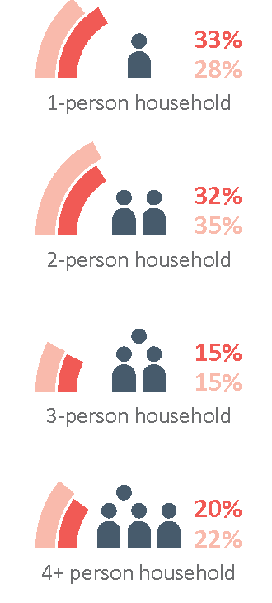
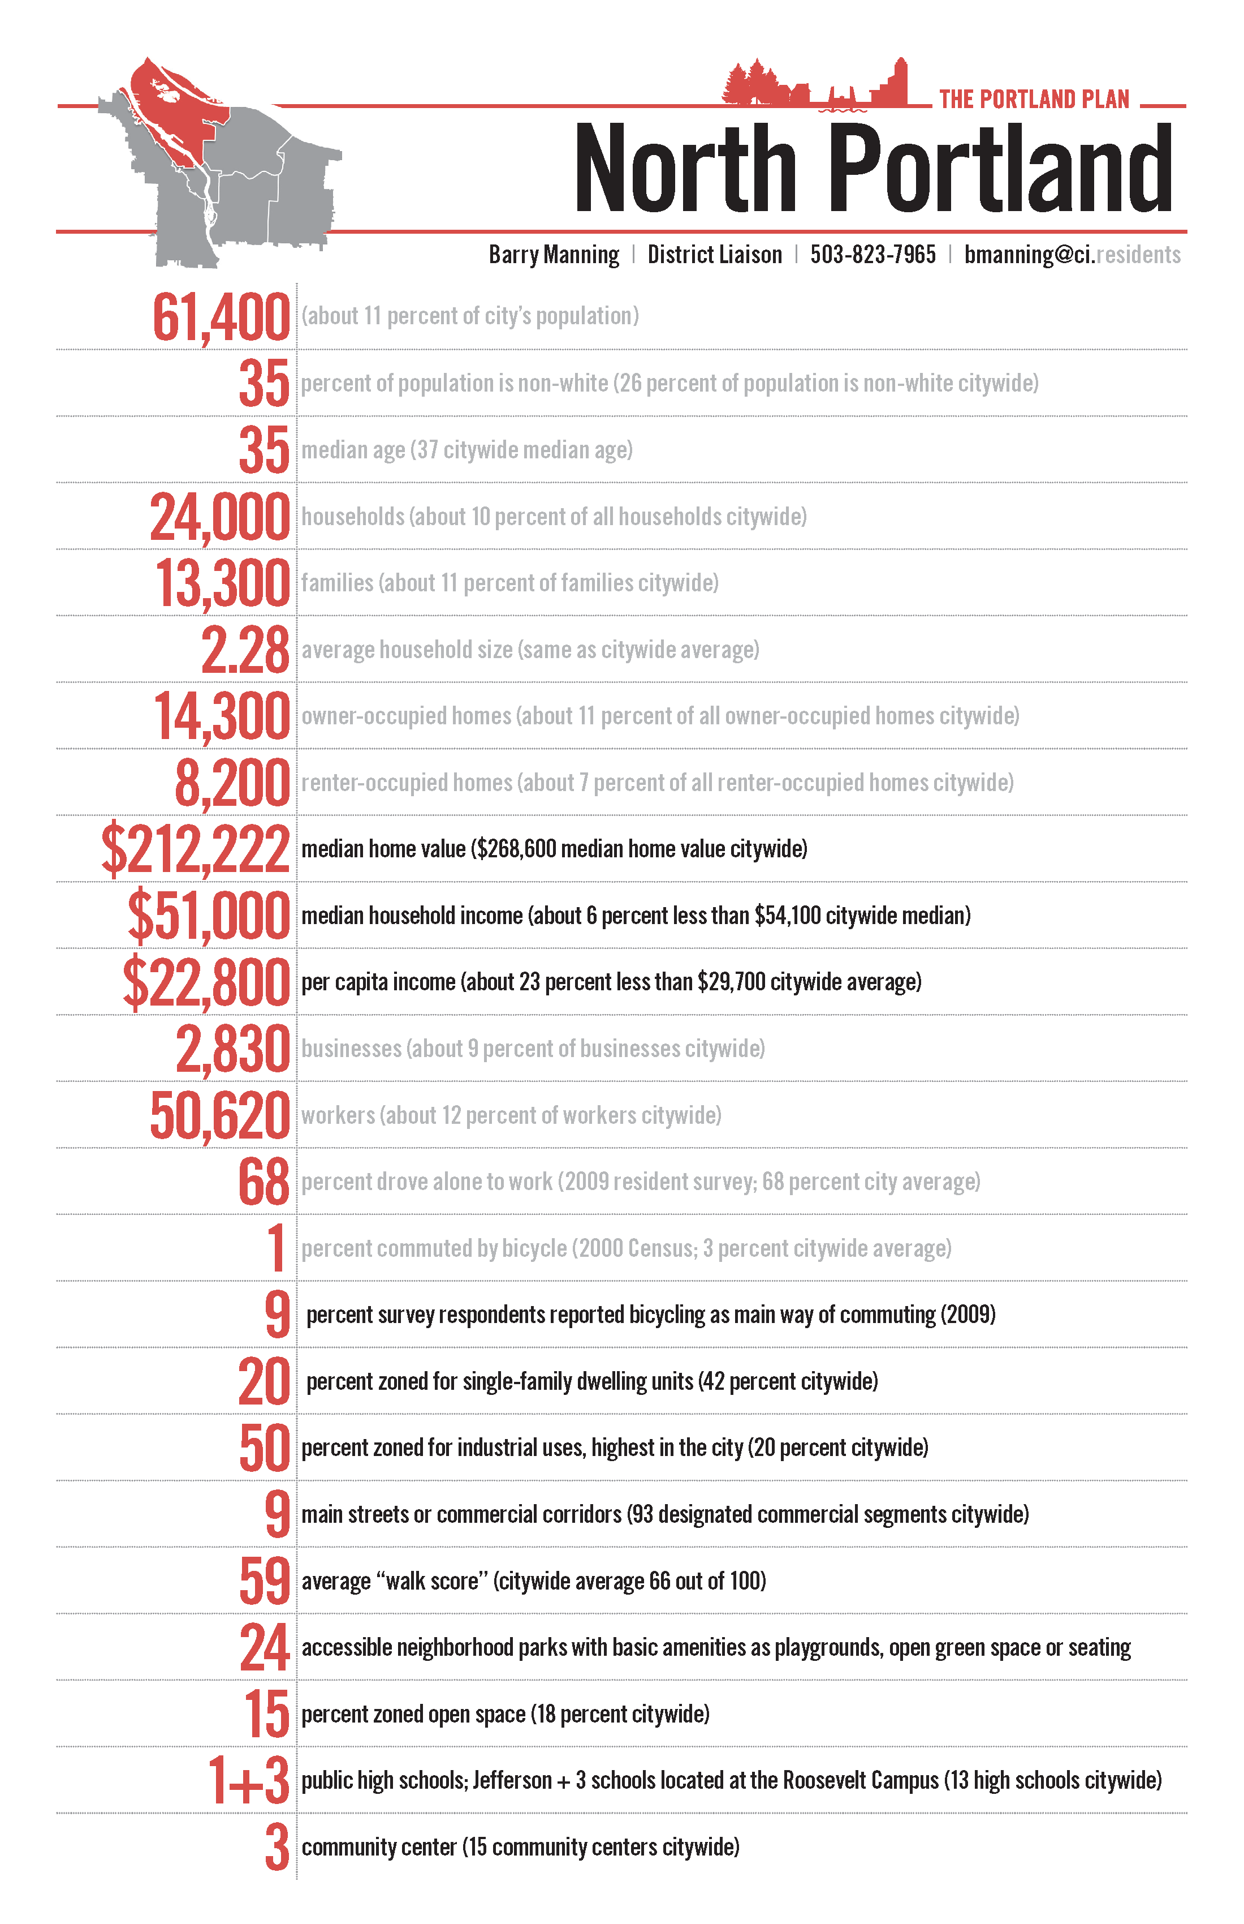
Community Profile
sample
Notes:
Community profile – provides key information about the neighborhood area; would like it to be graphic and easy to absorb without a lot of reading

Slide 12
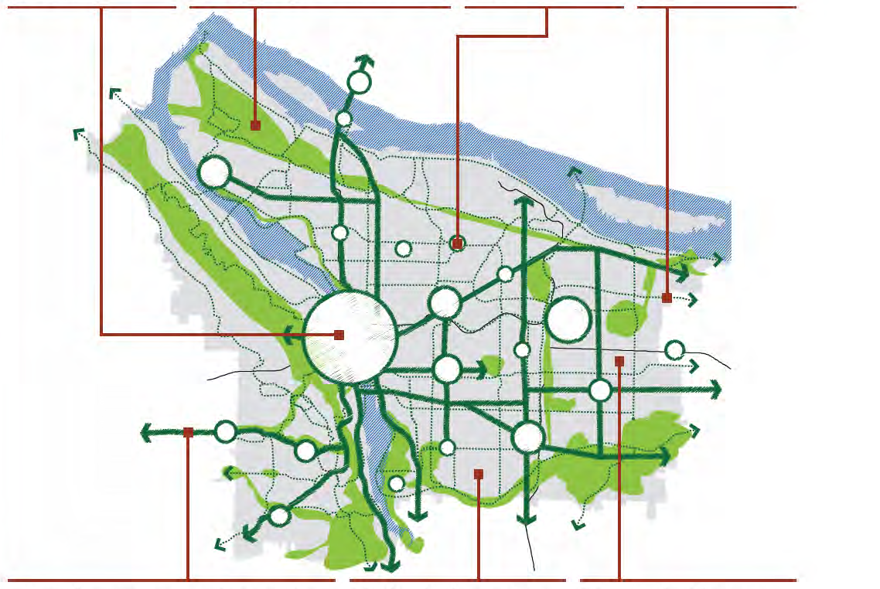
Opportunities Map
-Assets
-Strengths
-Opportunities
-Distinctive features
-Issues
-Assets
-Strengths
-Opportunities
-Distinctive features
-Issues
-Assets
-Strengths
-Opportunities
-Distinctive features
-Issues
-Assets
-Strengths
-Opportunities
-Distinctive features
-Issues
sample
-Assets
-Strengths
-Opportunities
-Distinctive features
-Issues
-Assets
-Strengths
-Opportunities
-Distinctive features
-Issues
-Assets
-Strengths
-Opportunities
-Distinctive features
-Issues
Notes:
Opportunities map – will be a map spread in the plan that will include call out boxes showing geographically where people have identified opportunities and issues/concerns. Will develop in the Discovery phase of the project

Slide 13
Relationship to Comprehensive Plan
Comprehensive Plan guidance | How does this relate to the neighborhood? | Neighborhood area strategies and actions
Land Use
Residential policies seek to maintain stability and vitality of neighborhoods; promote small-scale activity areas that provide informal meeting places; support neighborhood efforts to maintain and enhance character; help communities maintain local distinctive character while recognizing evolution over time. | Interest in preserving neighborhood character Interest in considering how to create more informal meeting places | Develop neighborhood-based tool bank, skills bank to support home maintenance Identify possible informal gathering places and options for future implementation
Environment
Policies that protect and enhance natural resources; reducing air and noise pollution; set tree canopy goal; address minimizing impacts on the environment through green building and curtailing waste. | Interest in preserving existing trees and increasing tree canopy Interest in neighborhood stewardship of natural areas Interest in expanded participation in recycling and composting | Create a neighborhood based program to support future tree inventory, management and planting Develop a local program for waste reduction Promote native vegetation planting through education and events
sample
Notes:
Comprehensive plan – short piece on how neighborhood interests and priorities relate to the Comprehensive Plan – matrix that will help focus on the relationship and guidance provided

Slide 14
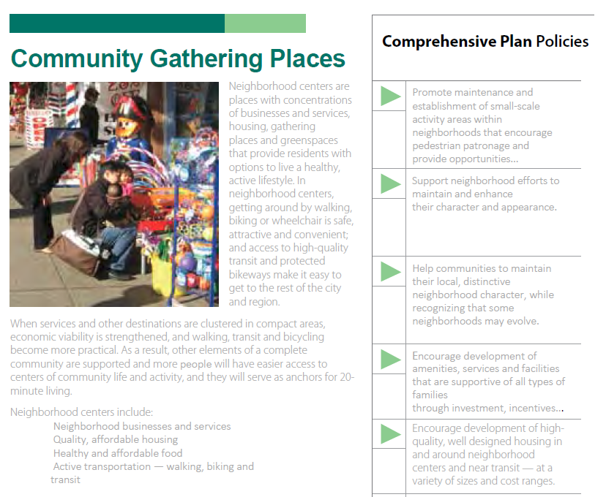
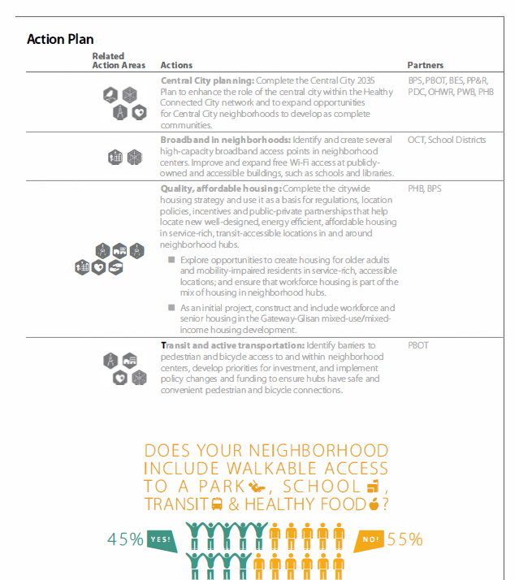
Vision and Strategies
sample
Notes:
Vision and strategies –
Vision
Each strategy – a short description, related CP plan policies, specific actions, lead and partners for actions, neighborhood priority, examples/case studies to help illustrate the strategy

Slide 15
A neighborhood area plan does: | A neighborhood area plan does not:
Focus on neighborhood priorities | Conflict with citywide policy guidance or regulatory direction
Maintain consistency with the City’s values and vision City Council vision Comprehensive Plan Land Use Code | Result in actions that impact the entire city or region
Notes:
Opportunities map – will be a map spread in the plan that will include call out boxes showing geographically where people have identified opportunities and issues/concerns. Will develop in the Discovery phase of the project

Slide 16
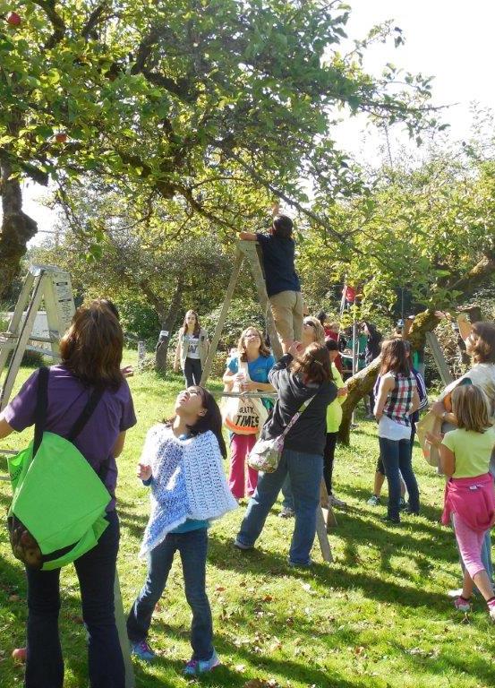
Outcomes
Priorities and initiatives
Neighborhood-based actions
Inform future Comprehensive Plan updates
Sense of ownership
Notes:
Outcomes
Tangible – neighborhood area plan – that informs priorities and neighborhood scale actions that will achieve the goal of adapting to change and maintaining what is valued
Intangible – will have gathered a lot of information some of which may not be appropriate for the neighborhood plan, but has value for the future comp plan, other departments,
Sense of relevance/ownership in the neighborhood

Slide 17
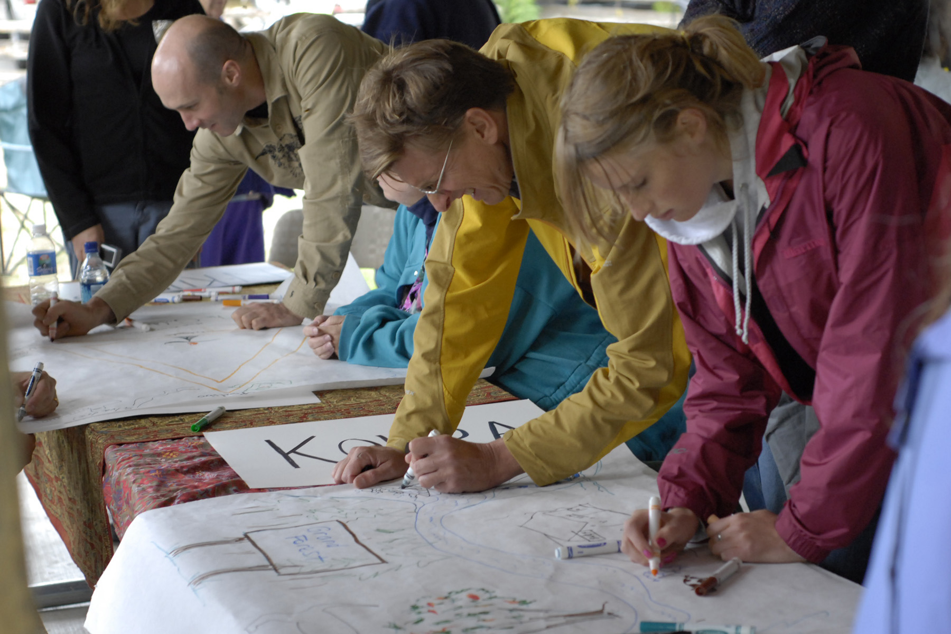
Neighborhood plans:
will be completed in a
one-year time frame
Notes:
Given that this is going to be very much a citizen driven program, important to keep our ask of people’s time reasonable while at the same time providing enough time so that there is space and room for meaningful conversation
One year time frame
Requires organization and structured work program

Slide 18
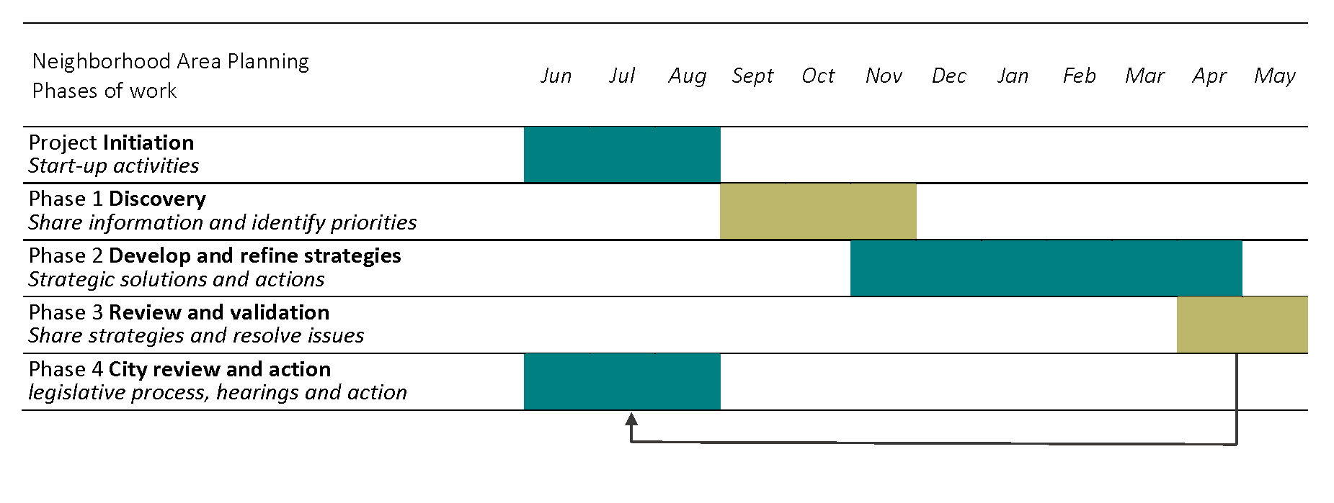
Work Program
Notes:
Two neighborhood areas at the same time
One year planning process
Follow school-year schedule
Discovery – hear more about what is important to the neighborhood; two way conversation – chance for city stakeholders to talk about important priorities
In-person meetings, walks, photography, online forums
Result in the opportunities map that I mentioned earlier
Develop and refine initiatives – roll up sleeves work sessions to turn preliminary ideas into more developed strategies and actions
Meetings, online forums
Tactical urbanism project
Review and validation – confirm understandings, resolve outstanding issues, achieve agreement on strategies
In-person and online communication
Achieve recommendation from the whole

Slide 19

Neighborhood plans:
depend on a collaborative relationship between the city and residents
Notes:
We cannot and do not want to create a neighborhood plan from city hall
We will be working in partnership with the neighborhood

Slide 20

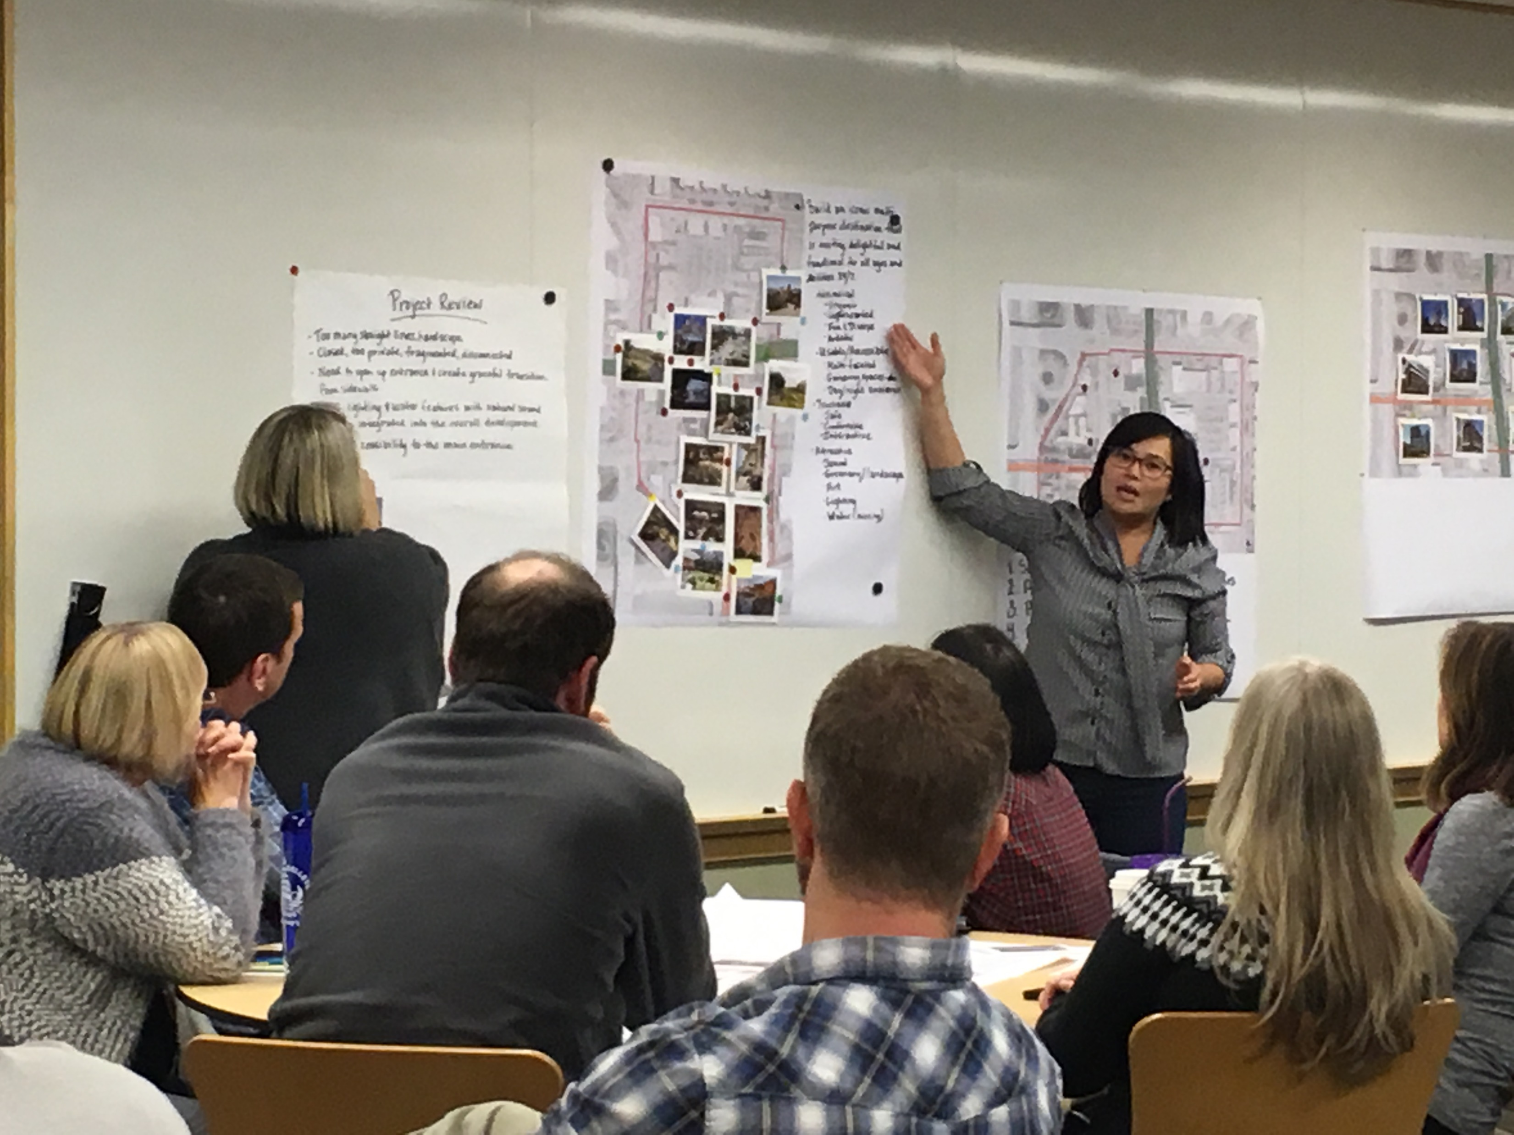

Neighborhood Engagement
Grass roots
  Neighborhood associations, community groups, faith networks, business, schools
In person, In neighborhood
Neighborhood workshops
  Trained citizen facilitators
Emphasis on participatory activities
Online engagement
  surveys, forums, maps
Notes:
Historically under-represented – multifamily residents, new residents, families with young children, young adults, speakers of English as a second language
People who are and have been active – insights and knowledge
Flexible communication – online and in person opportunities at different times of day and in different formats
Citizen facilitators
Recommendations of the whole
Examples – meetings, interactive online engagement, small group meetings, youth and school involvement, walking tours, photography, story telling, artist supported activities, and other ideas that come from the neighborhood

Slide 21

Neighborhood plans:
will be organic, fun and informative
Notes:
Organic – activities will arise out of neighborhood interests; have a public engagement program with a menu of possible activities, but want what we are doing reflect and be tailored to neighborhood interests and needs
Include food, activities to build meaningful conversation and connections, at to provide creative thought and ideas
Informative – we know that city staff will learn a lot as we spend time in the neighborhoods, and we also want to be sure to provide a program that is informative and helpful for the people who participate

Slide 22
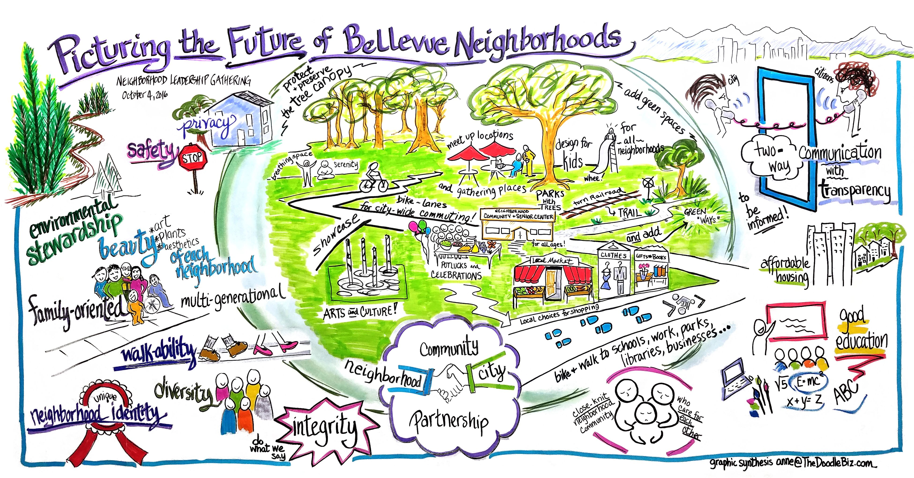
How will we know if we are successful?
Updated plans are relevant to neighborhoods and city
  Neighborhood Character
  Adaptability
  Social Connectivity
  Core Needs
High community ownership

Slide 23
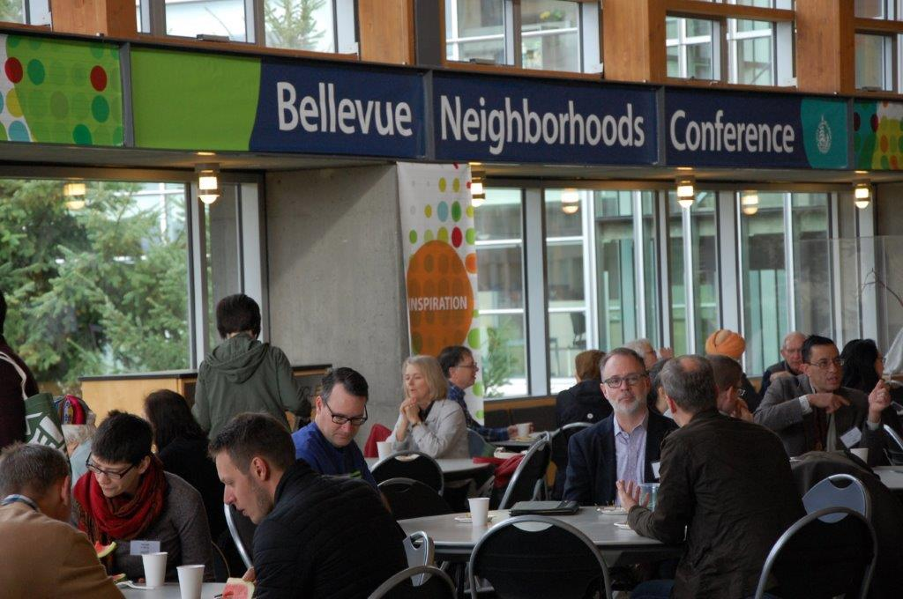
Next steps
No action requested tonight
June 12 Neighborhood Leadership Gathering meeting – 6-8pm @ 1E-108, City Hall
Report back to Council and ask for direction for next steps

